Slide 1
To what extent can we identify distinct instruments and country policy goals that reflect a novel co-creation approach vs. a more traditional knowledge-transfer approach?
Team Aalborg University

Slide 2
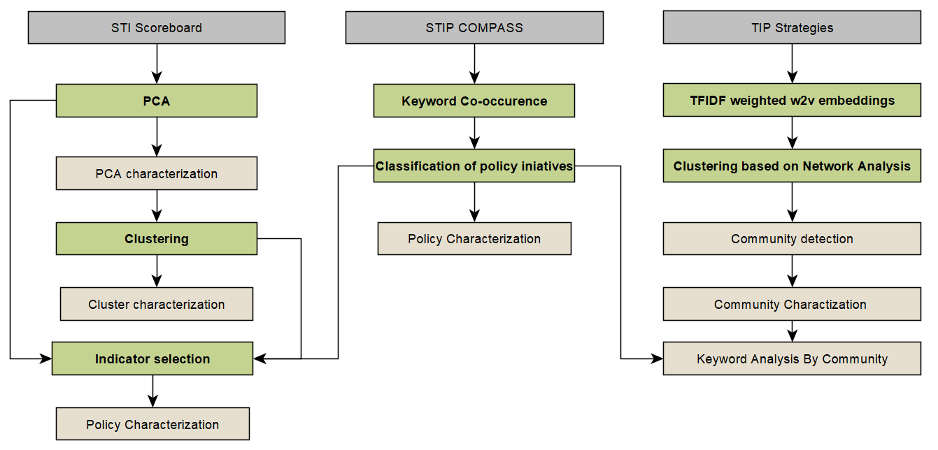
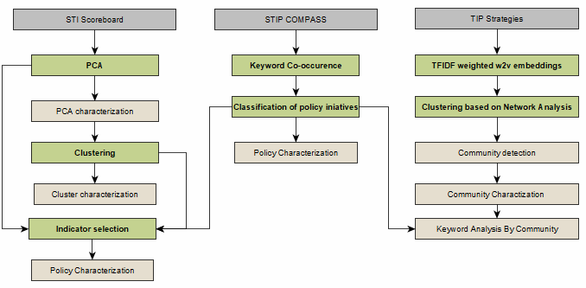
Overall workflow
Notes:
1 min
3 different STI databases, each with different techniques.
T

Slide 3
Overall workflow
Notes:
the policy initiatives are classified based on the keyword co-occurrence in co-creation and knowledge transfer categories.
Then, the info about this classified group of policies is integrated into models on the left and right.

Slide 4
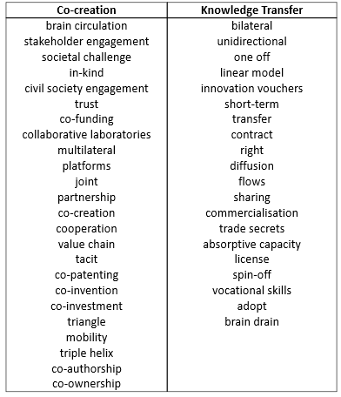
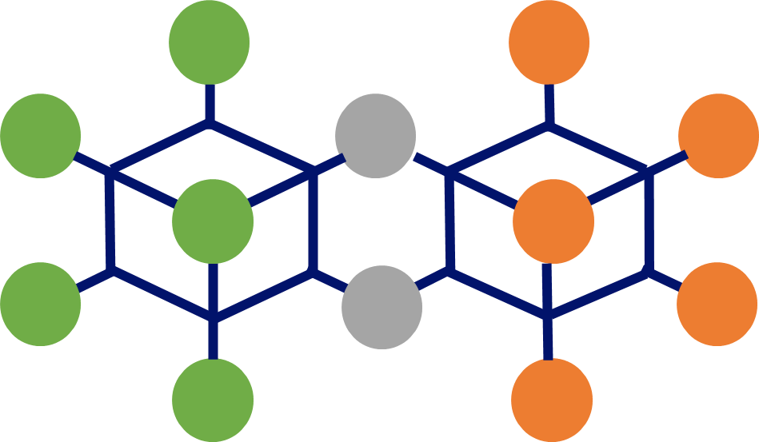
Classification Method
Co-creation
keywords
Knowledge Transfer
keywords
Notes:
First the keywords that are closely related to co-creation and knowledge transfer are selected, based on suggestion by our team leader, Tiago Santos Pereira.
Then we use a network analysis method to find co-occurred keywords in each category, including those which are shared by both.

Slide 5




Classification Method
Keywords/Tags
Joint projects
Trust
International cooperation
70% Co-creation
keywords
Triple helix
Co-authorship
Brain circulation
Policy Initiative #1
International mobility
Diffusion
30% Knowledge Transfer keywords
Innovation vouchers
Technology transfer
Co-creation policy
Notes:
As one policy can have many keywords up to 30. We assign it into a specific category based on the weight of the associated keywords.
E.g., if a policy contains 70% co-creation keywords, and 30% KT keywords, then it has higher emphasis on co-creation activities and thus, is assigned into the co-creation category.

Slide 6
Overall workflow
Notes:
the policy initiatives are classified based on the keyword co-occurrence in co-creation and knowledge transfer categories.
Then, the info about this classified group of policies is integrated into models on the left and right.

Slide 7
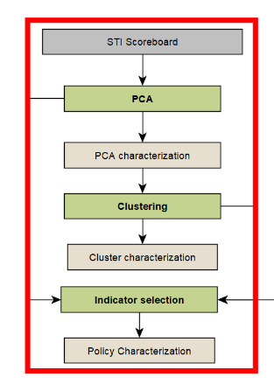
Overall workflow
Selected Indicators:
Gross domestic expenditure on R&D (GERD)
% of GDP
Financed by business enterprise
Higher education expenditure on R&D (HERD)
Financed by business enterprise
Government expenditure on R&D (GOVERD)
% GDP
Financed by business enterprise
Business enterprise expenditure on R&D (BERD)
% of GDP
Financed by business enterprise
Co-patenting
International co-invention % of total PCT patent applications

Slide 8
Overall workflow
Notes:
the policy initiatives are classified based on the keyword co-occurrence in co-creation and knowledge transfer categories.
Then, the info about this classified group of policies is integrated into models on the left and right.

Slide 9
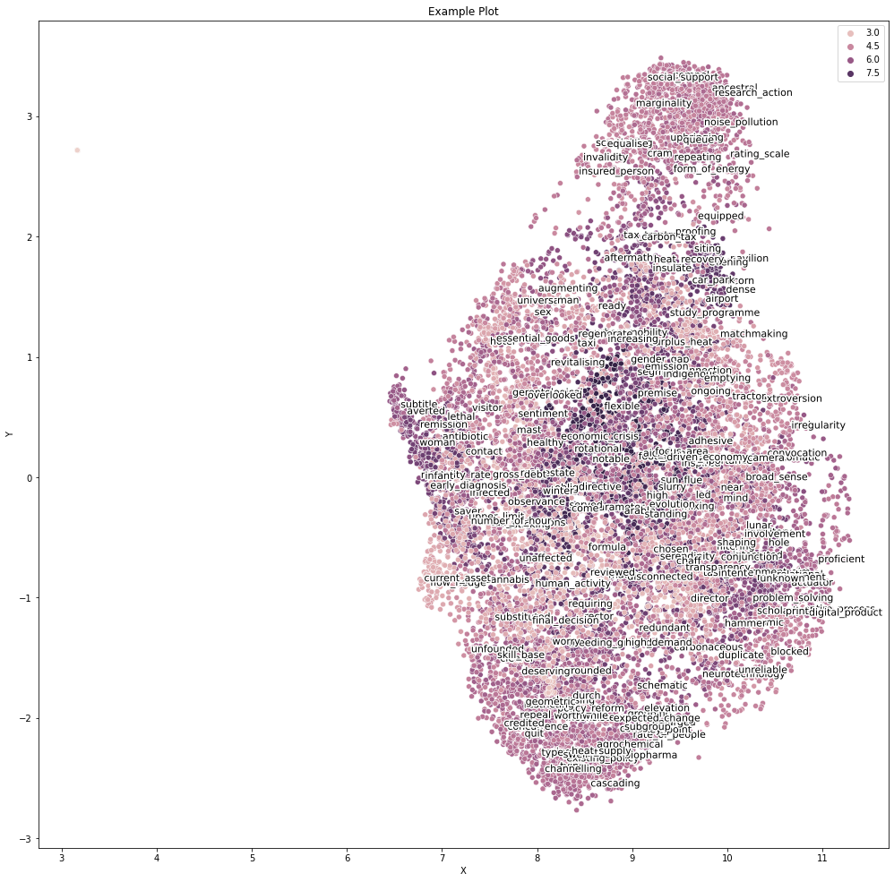
TFIDF weighted w2v embeddings
Computing a vector for each word in the relevant text
300 dimensions for each word
Finally, computing a policy vector based on the average of included words in each policy

Slide 10
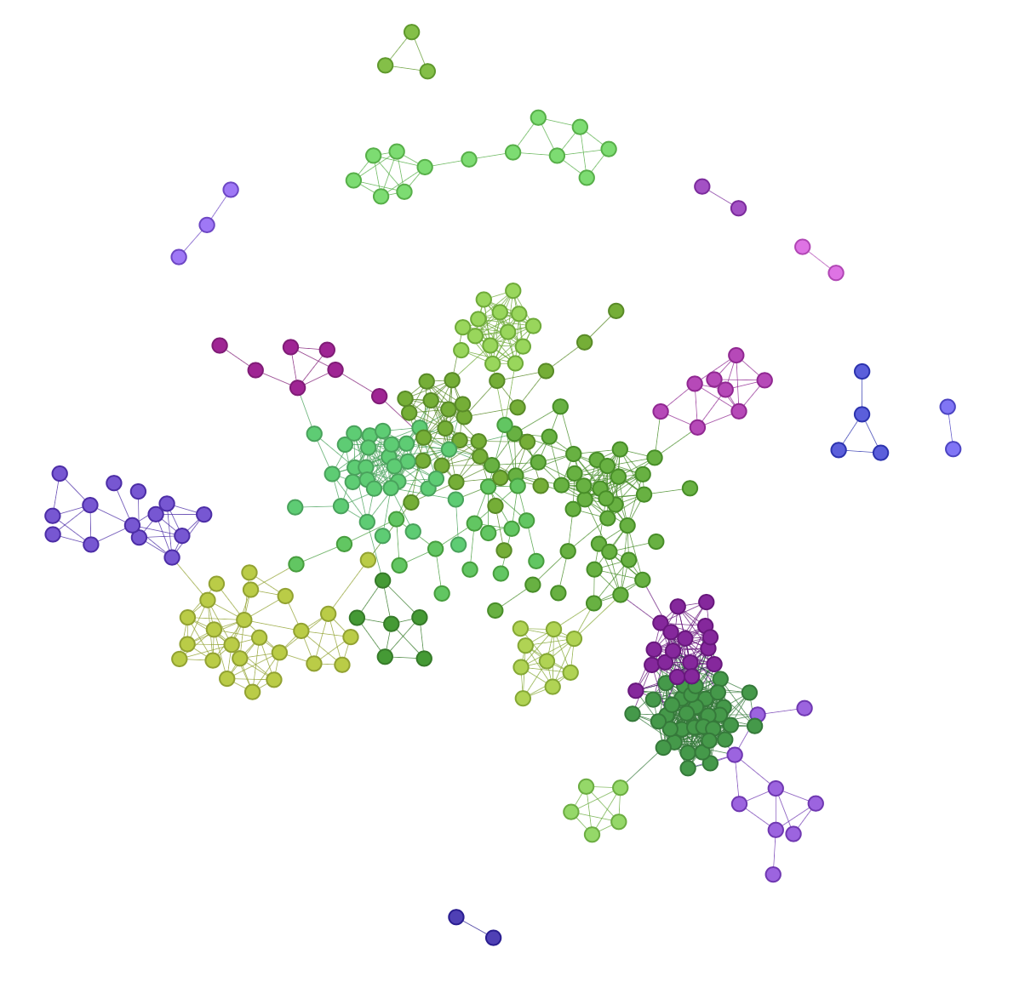
TFIDF weighted w2v embeddings and Network Analysis (Semantic Similarity)
Government-university R&D
AI development and its application
Nodes: Policies
Edge: Semantic Similarity Score
Climate Change
Sustainable energy development
Investment programme which involves government support

Slide 11

Results
Notes:
3 mins Katie
1 min Arne

Slide 12
Top countries with the most diversified target groups
Mexico & Slovak Republic – Research and education organizations
Ukraine – Researchers, Students, Teachers
Belgium – Firms
Thailand – Intermediaries
Malaysia – Government Entities
Mexico – Economic actors
Romania – Social groups
Category | Average number of actors
Co-creation | 4.221
Knowledge Transfer | 3.953
Both | 4.008
Notes:
FIrst, we wanted to at least verify that our classification is valid to some extent. Co-creation activities tend to have more diversified target groups, and our calculation of the average number of actors in co-creation is higher. These are the list of countries which have the highest numbers of actors in each target group.

Slide 13
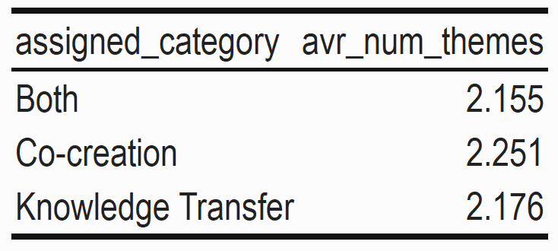
Top 10 countries with the most diversified themes
Co-creation
Country | Mean no. of themes
Republic of North Macedonia | 6.500
Mexico | 5.000
Czech Republic | 4.000
Belgium - Brussels Capital | 3.500
Denmark | 3.273
Germany | 3.267
Ireland | 3.143
Belgium - Federal government | 3.000
Bosnia and Herzegovina | 3.000
Serbia | 3.000
Knowledge Transfer
Country | Mean no. of themes
Czech Republic | 3.700
Belgium - Flanders | 3.400
Republic of North Macedonia | 3.333
Bosnia and Herzegovina | 3.25
Cyprus | 3.125
Mexico | 3.000
Slovenia | 2.889
Turkey | 2.774
Peru | 2.667
Canada | 2.652
Notes:
Again, we would like to validate whether co-creation policy will as well have more diversified themes.
Although the table on the top right shows not much difference, the list of top 10 countries have higher average number of themes in co-creation than knowledge transfer.
Which countries do most co-creation this year (2021)? Republic of North Macedonia, Ireland, Bosnia and Herzegovina, Netherlands, Costa Rica, Denmark, Germany
Also specify that we are showing only policies with high % of keywords appear in one category and not both.

Slide 14
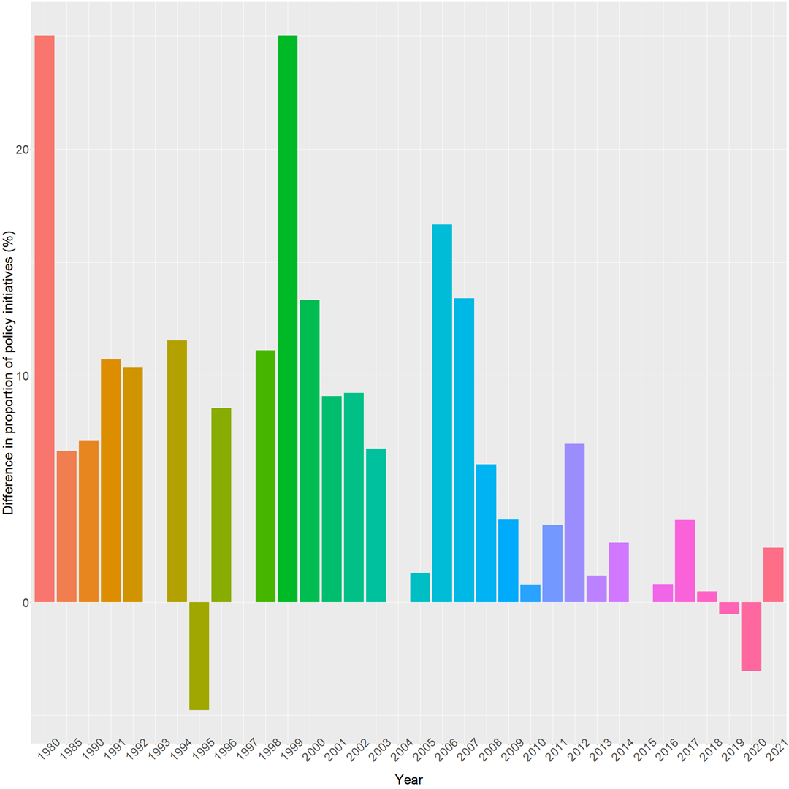
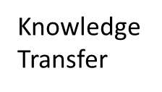

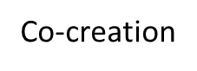
Differences in the proportion of co-creation policies vs. knowledge transfer policies
Notes:
We plot the percentage differences in proportion of co-creation vs. KT policies. This graph shows that there are more co-creation policies than knowledge transfer during 2019 and 2020, despite the odd in 1995.

Slide 15
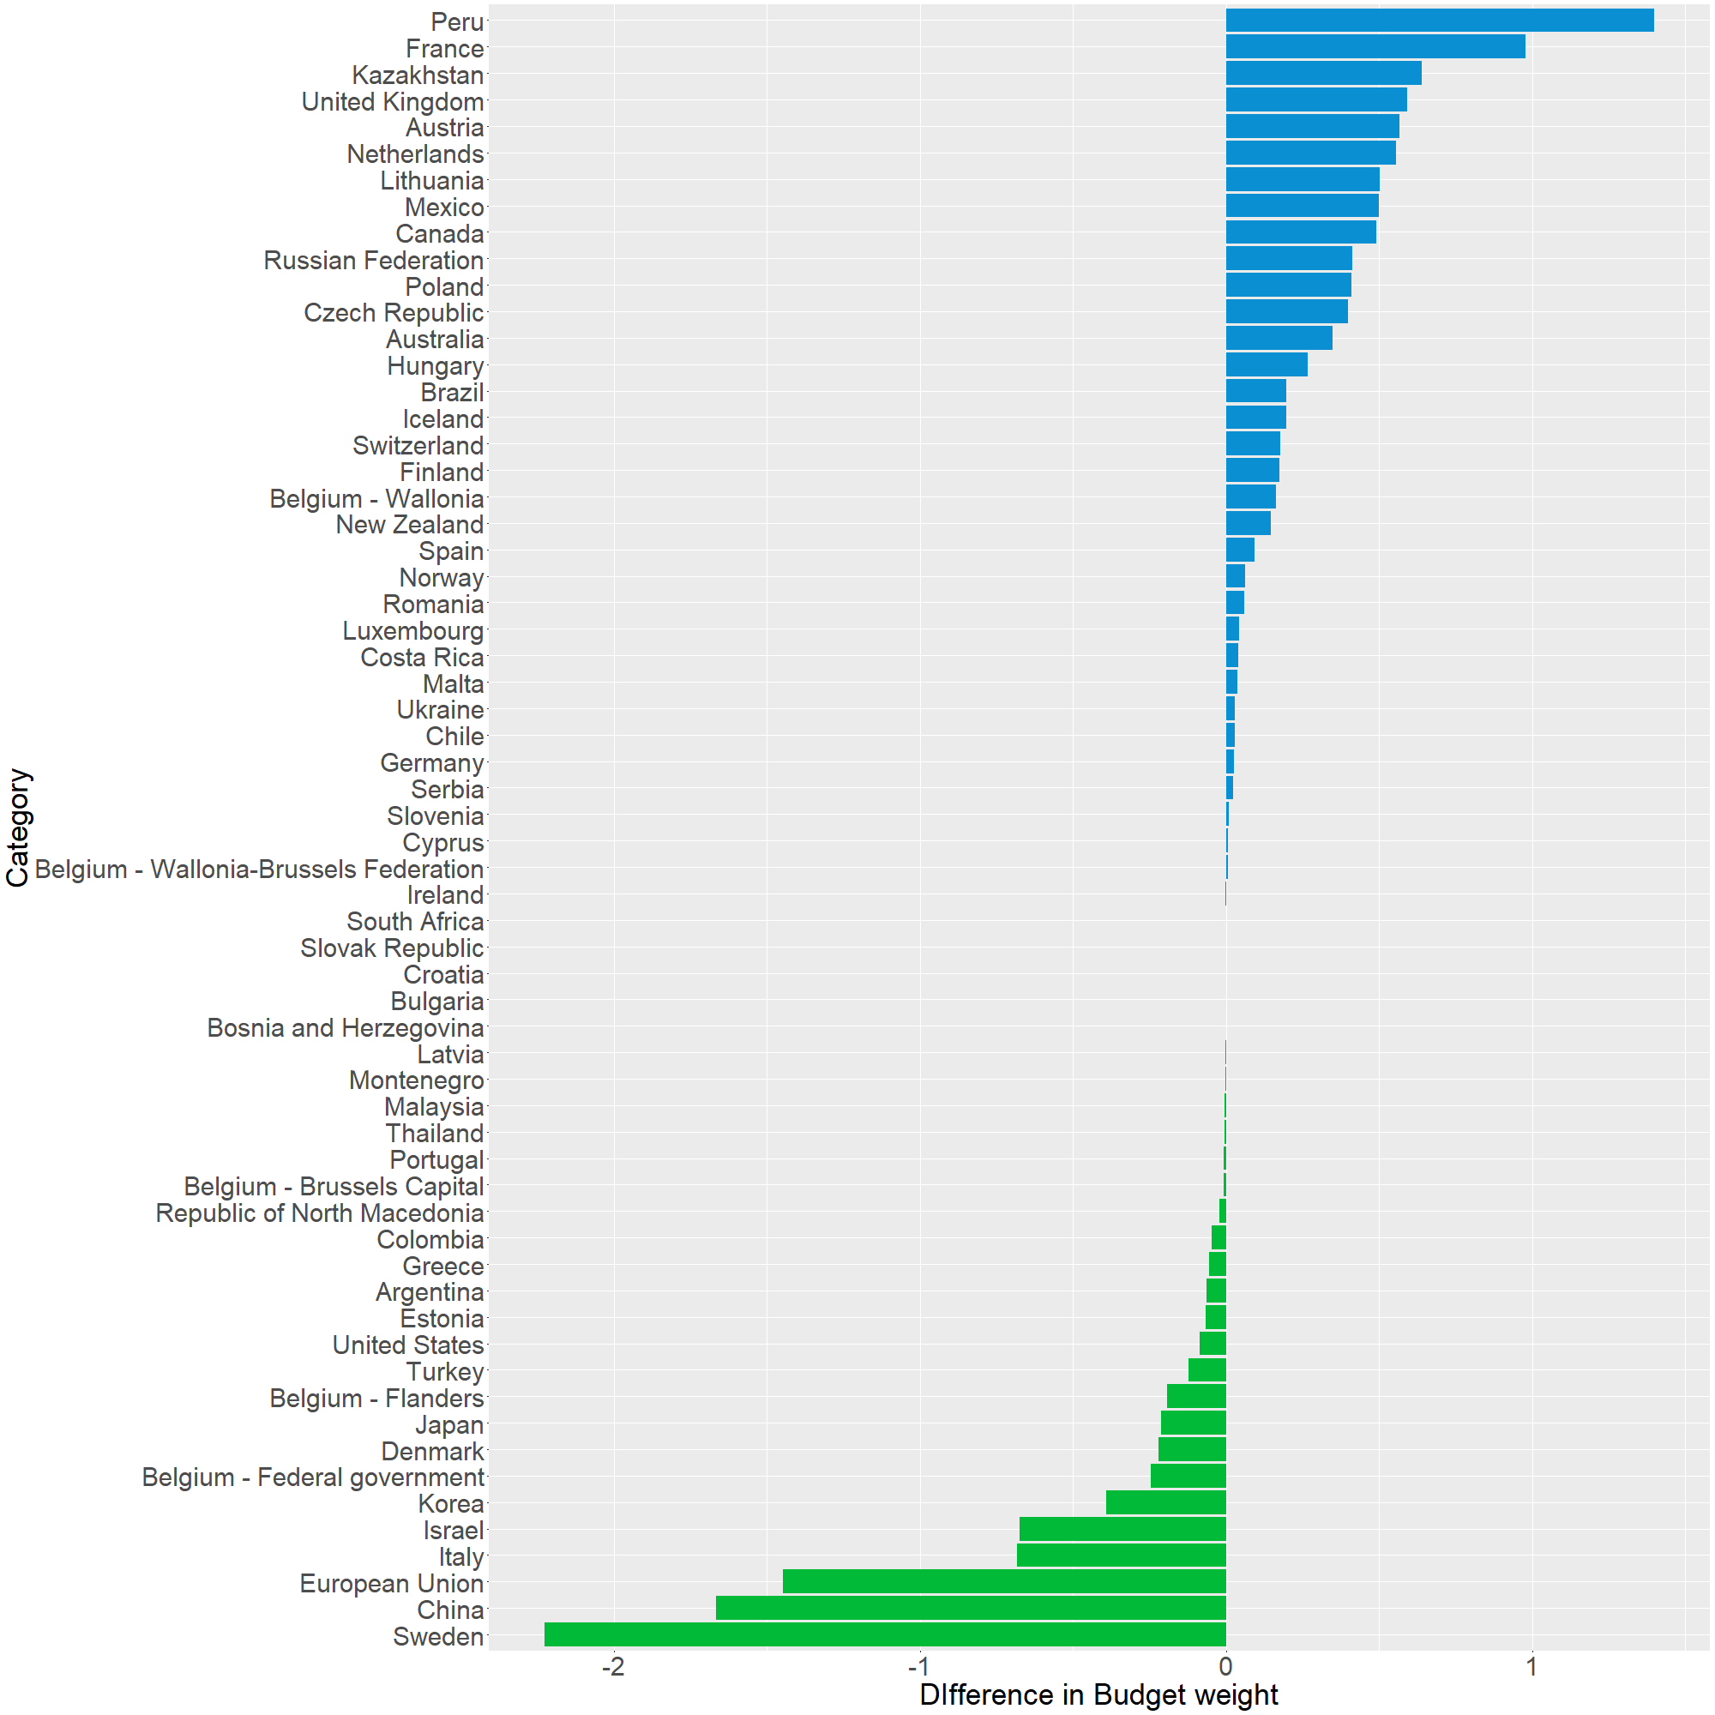

Differences in the budget weight between co-creation policies vs. knowledge transfer policies
Notes:
Countries such as some from the European Union, China, the US, Korea etc. put relatively higher budget in co-creation policies, but there are also some developing countries that want to put more budget in this.
*Japan & Belgium are included.

Slide 16
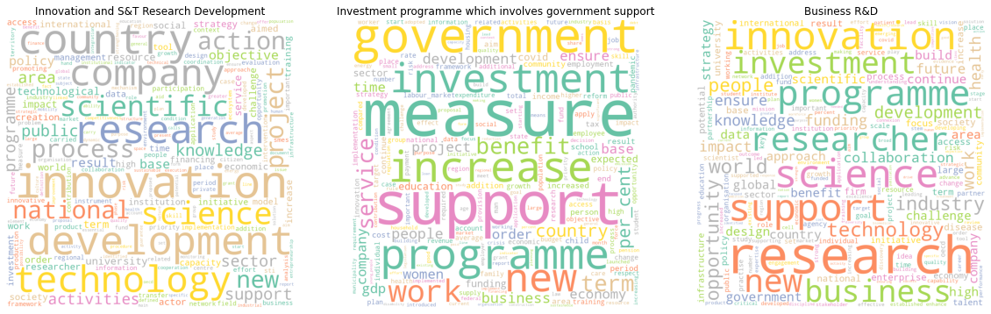
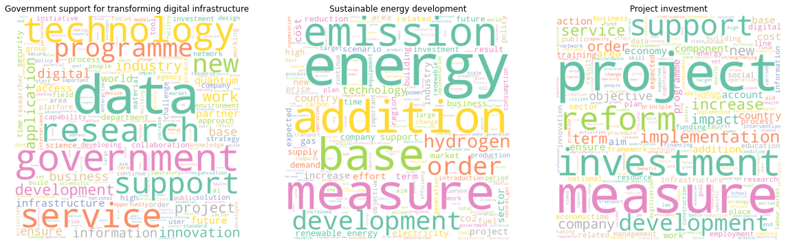
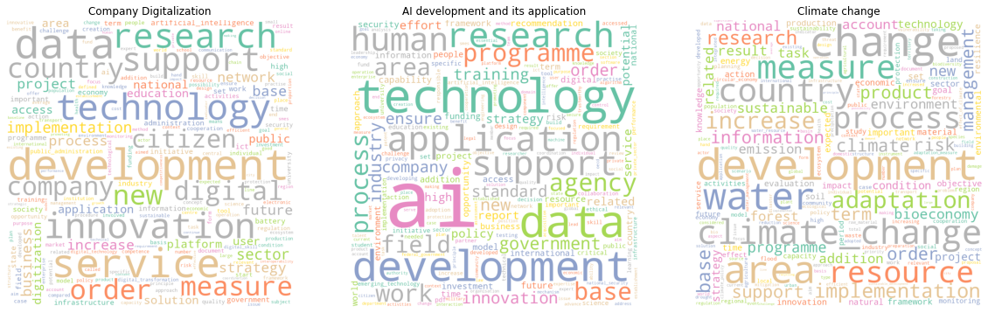
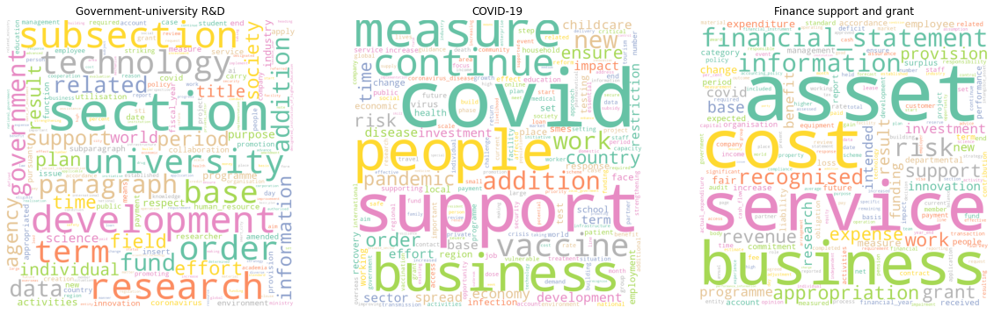
Communities topic based on common words in policy texts
Notes:
We show communities with high frequency of keywords in different topics. Some interesting topics are such as Energy, COVID, AI related, and climate changes which are also associated with co-creation topic.

Slide 17
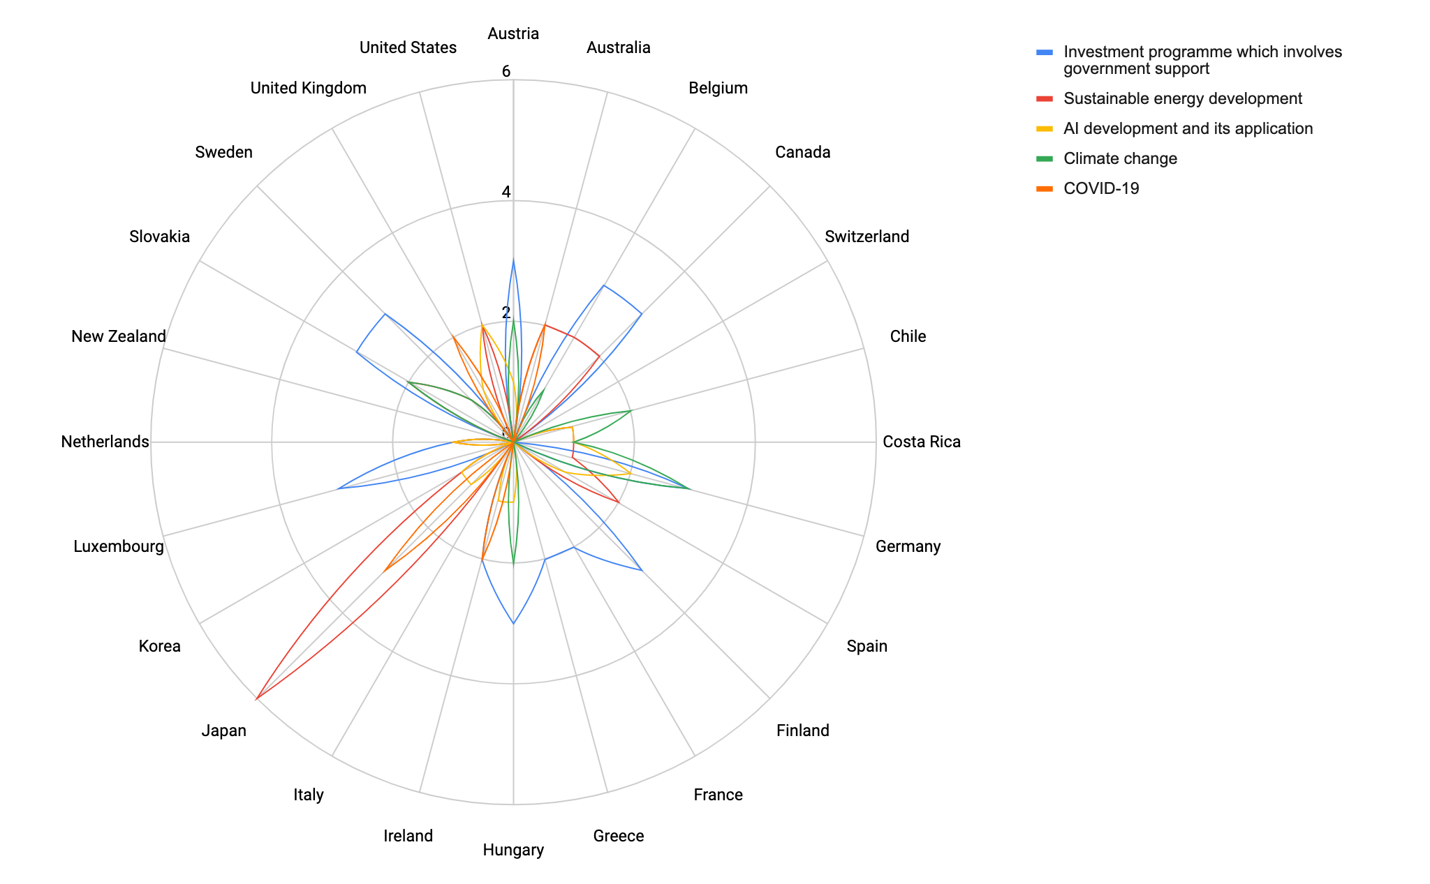
Timeline:
2013-2021
Notes:
This graph shows the communities that have high co-creation keywords.
The topics about sustainable energy and COVID-19 are prevalent in Japan.
Climate change in Germany and Slovakia.
Investment programme in European countries for majority.
And AI development in Germany as well.

Slide 18
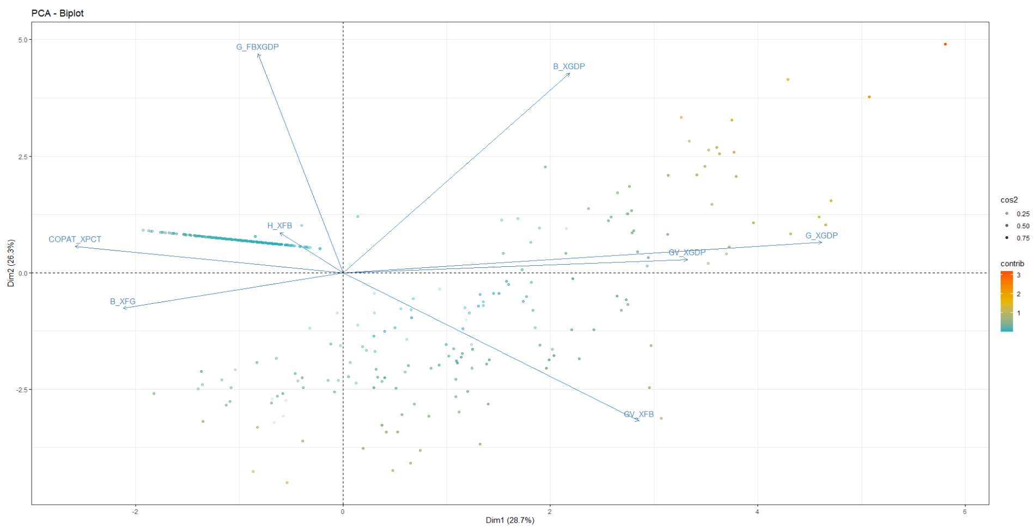
STI Scoreboard - PCA RESULTS
Most of the variables contributes to dimension 1
Dim 1. High correlation with both kt and cc initiatives
Dim 2. Small correlation with both kt and cc initiatives
Notes:
Note to Arne: Change the name of the indicators

Slide 19
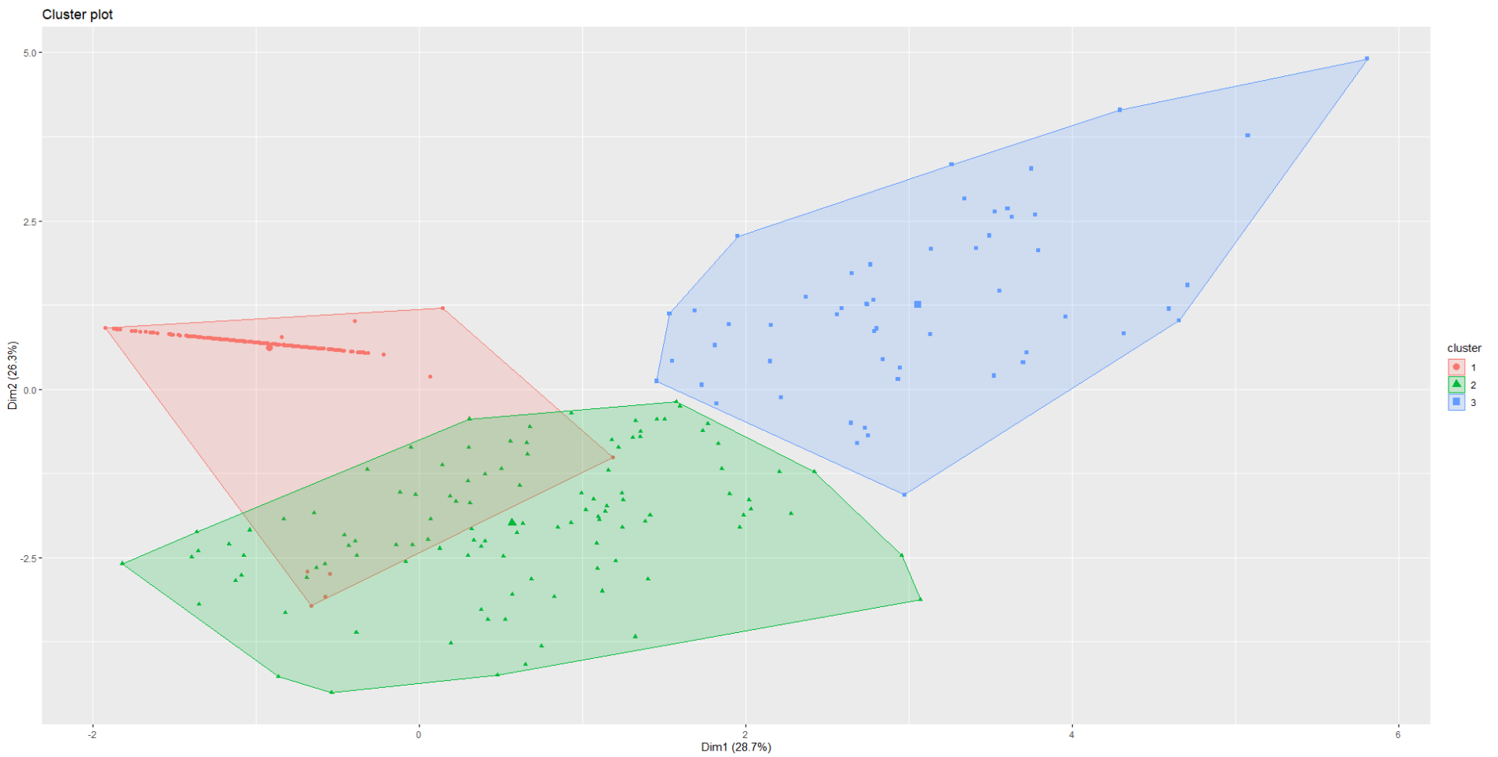
STI Scoreboard - Clustering
Guatemala
Armenia
Brazil
Germany
Denmark
Finland
Argentina
Spain
Australia

Slide 20
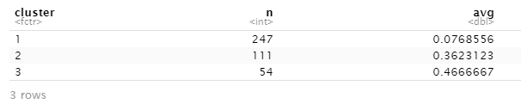
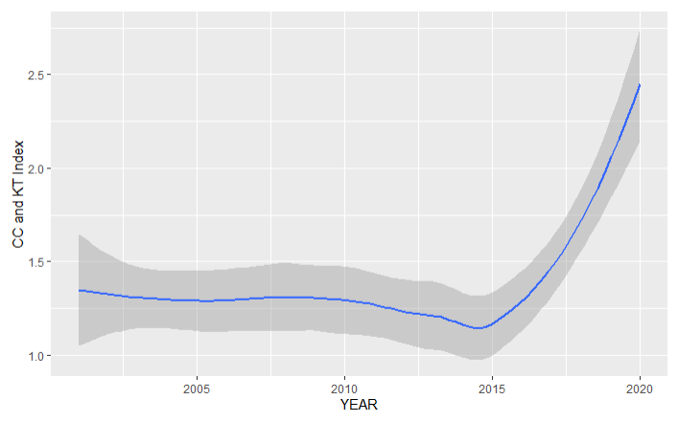
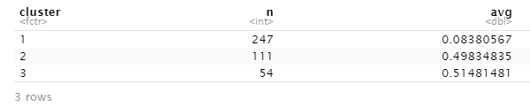
STI Scoreboard - Triangulation with STIP COMPASS
Average number of CC-initiatives pr. year by cluster
Knowledge transfer and co-creation over time
Average number of KT-initiatives pr. year by cluster
NOTE: Index is based on the variables correlating positively with KT and CC

Slide 21
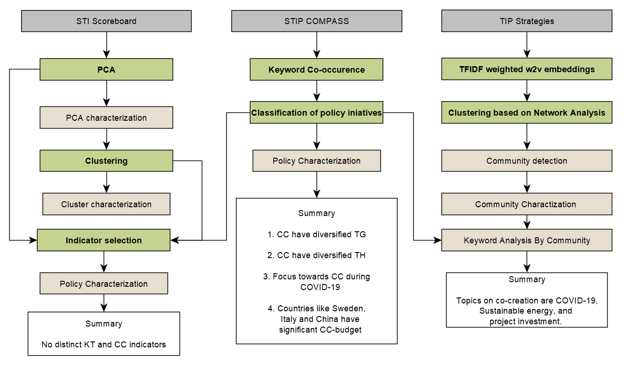
Summary
Notes:
Arne 1 min
2-3 key takeaways:
Co-creation is likely to have more diversified target groups and themes
Countries which put significant budget into co-creation policies are the European Union like Sweden, Italy, and China, Israel, Korea etc.
Topics in co-creation is about COVID-19, Sustainable energy, and project investment.

Slide 22
Future Suggestions
Using Named Entity Recognition (NER) for identifying relevant keywords for distinguishing between Knowledge Transfer and Knowledge Co-Creation policy documents
Using Sentence Transformer models for creating more accurate embeddings at the sentence level Instead of using the word2vec model
Notes:
30 sec
Entity Extraction - dictionary-based, give a label. Training the model. Keyword extraction from the abstract instead of keyword in SCOPUS.
Match full texts in policy doc with other texts.

Slide 23
Thank you!

Slide 24
Q & A!

Slide 25
Future suggestion from Tiago
Do a sensitivity test: How are outcomes changed when the keywords are tweaked?

Slide 26
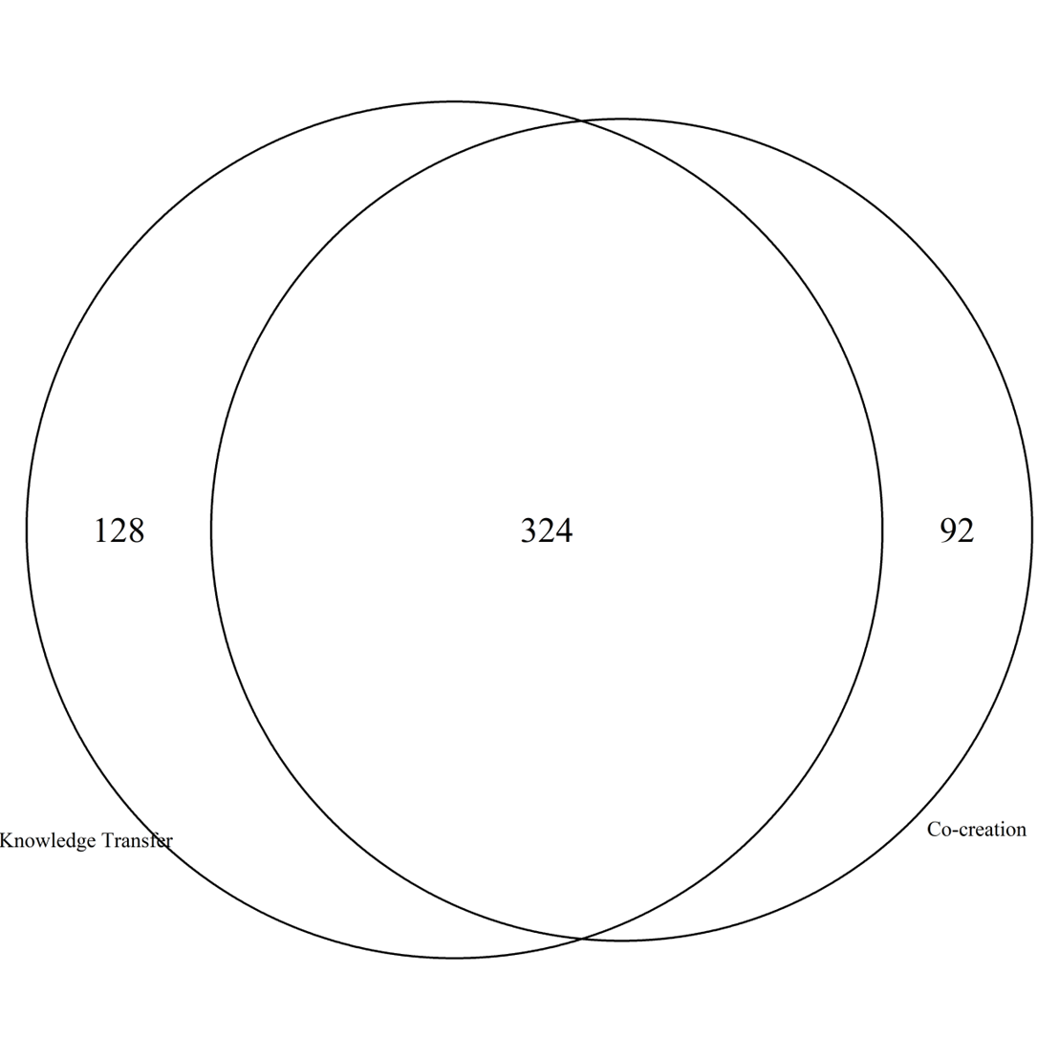
Appendix
Original plug-in keywords:
Co-creation: 24
Knowledge Transfer: 20
Total number of co-occurred keywords: →
Total number of policies:
Both (Highly-overlapped keywords): 4436
Co-creation (High % co-creation keywords): 562
Knowledge Transfer (High % knowledge transfer keywords): 695

Slide 27
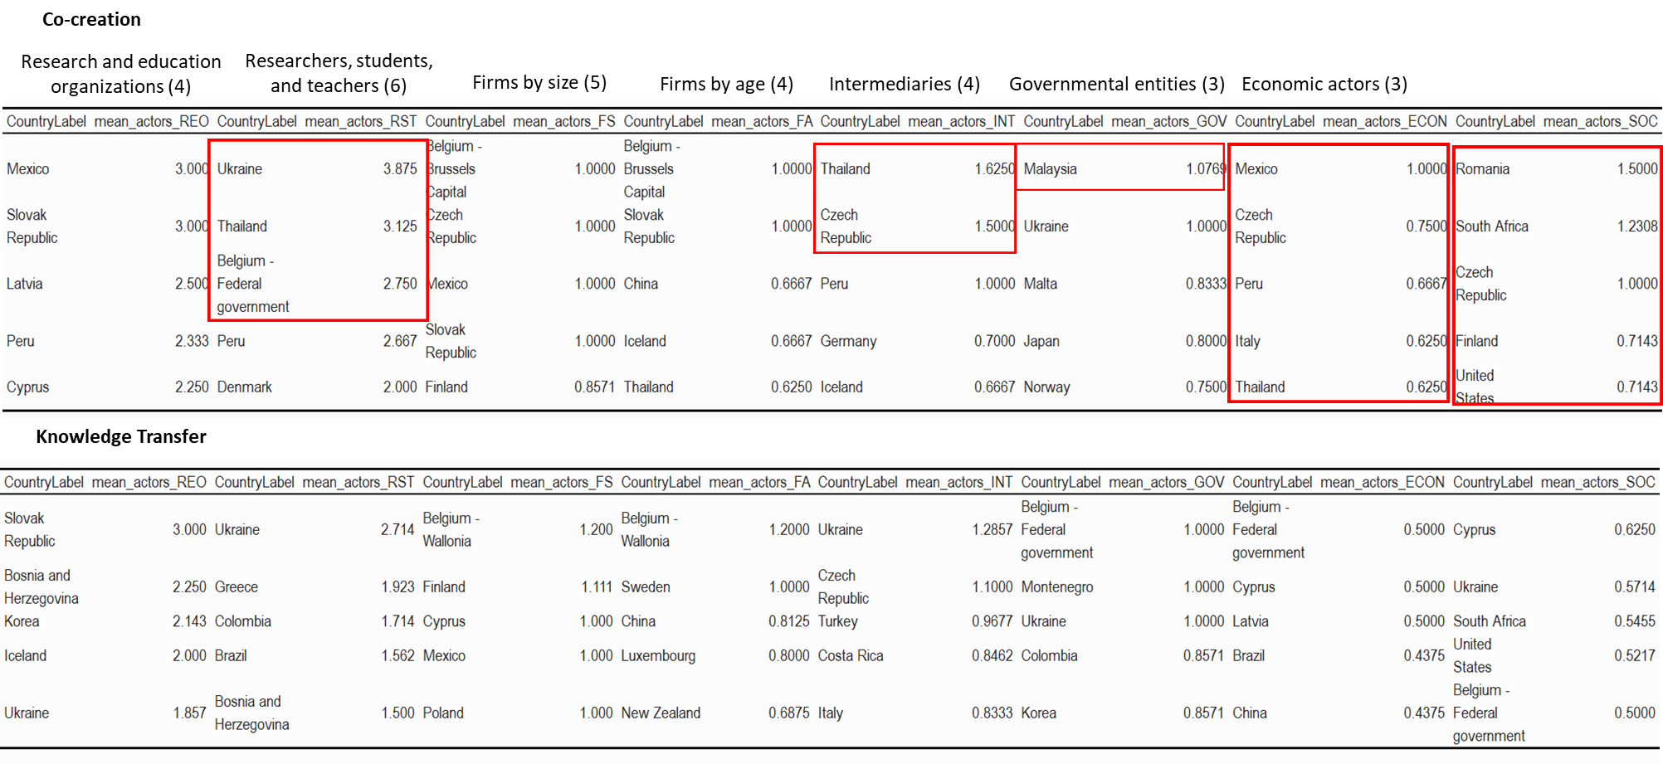
Appendix
Top 5 countries with the most diversified number of target actors in co-creation and knowledge transfer policies
Notes:
REO: 1) Higher education institutes, 2) Public Research Institutes, 3) Private Research and development lab, 4) Established researchers
RST: 1) Established researchers 2) Post-docs and other early-careers 3) Undergrad and Master 4) Secondary educ 5) PhD 6) Teachers
INT: 1) Incubators, accelerators, science parks, technoparks 2) Tech transfer offices 3) Industry associations 4) Academic societies/academies
GOV: 1) International entities 2) National government 3) Subnational governments
ECON: 1) Entrepreneurs 2) Private investors 3) Labor force in general
SOC: 1) Women, 2) Disadvantaged & excluded groups 3) Civil society
In continuation to slide 11, although the average difference is small (just 0.3), we did more tests on this chart and found that the top ranked countries show higher number of actors on average in co-creation policies than knowledge transfer policies.

Slide 28
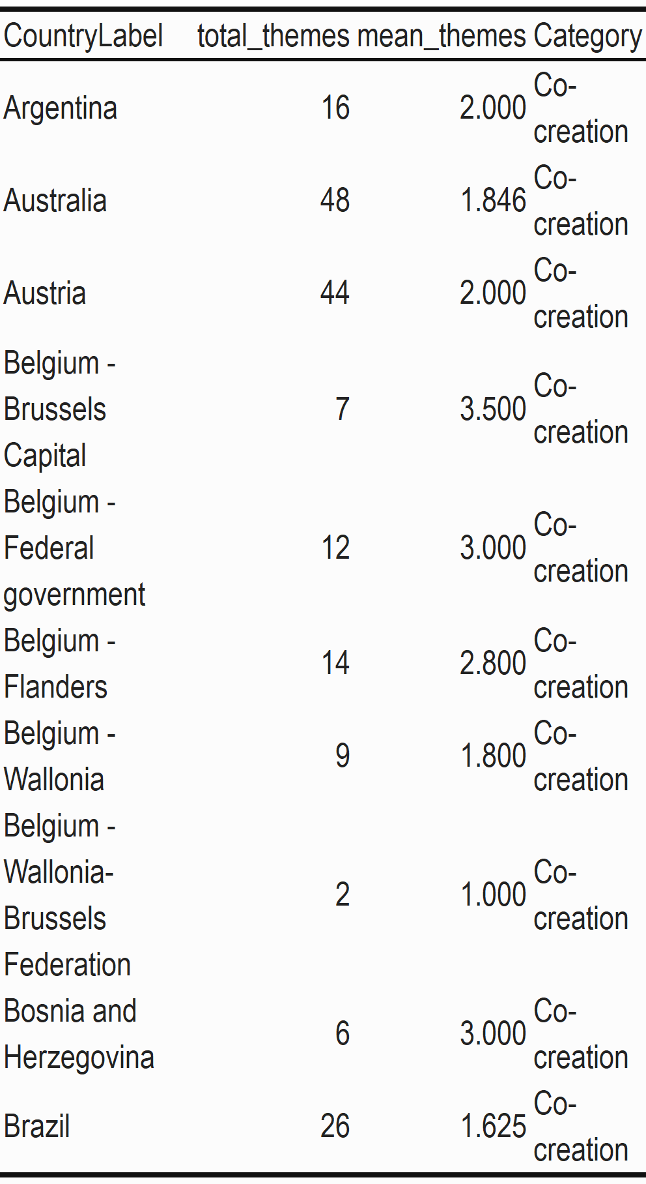
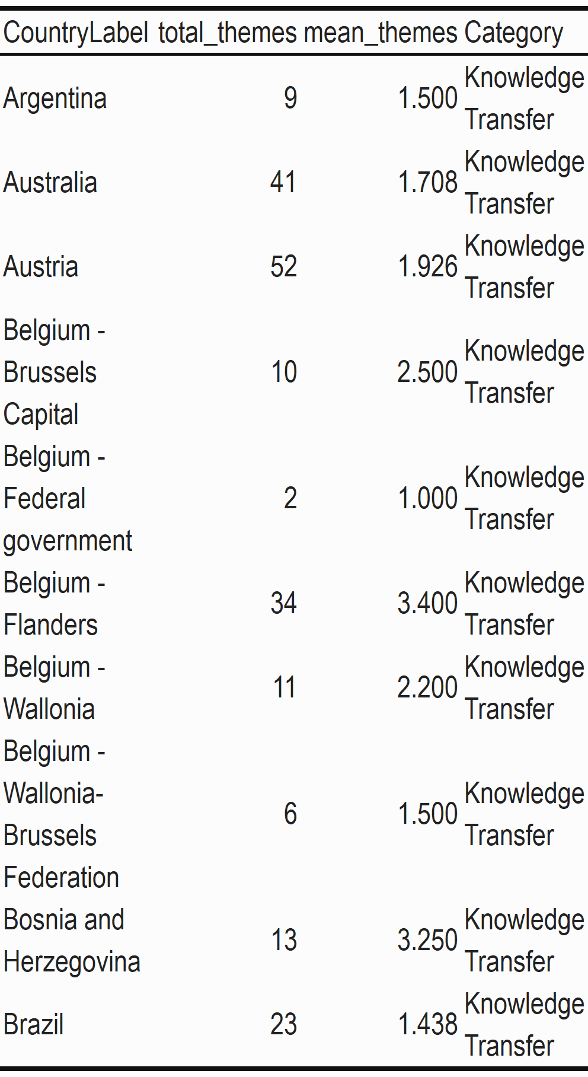
Appendix
Comparison of average number of themes in first 10 countries
Notes:
Comparing average number of themes within the same countries. Red box shows higher values in co-creation than knowledge transfer policies.

Slide 29
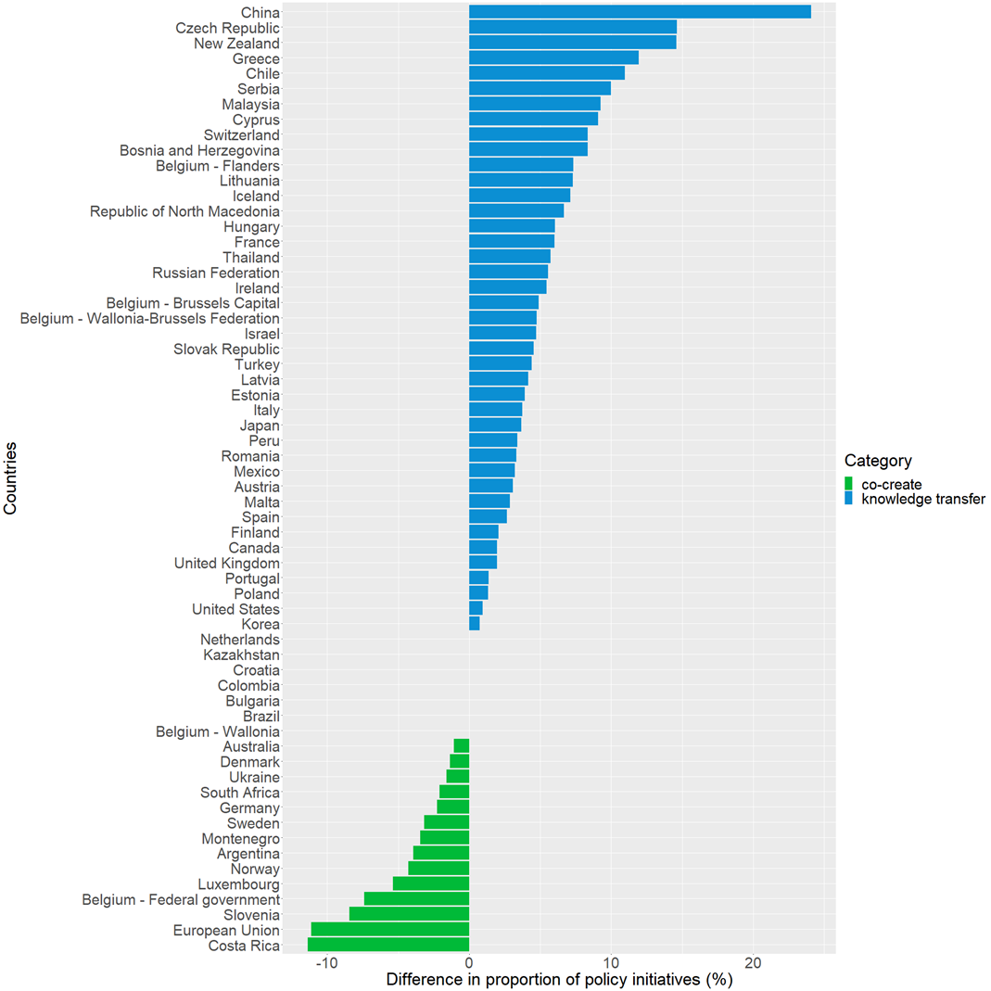
Countries with more percentage of co-creation policies
Notes:
Countries in EU and Costa Rica in Central America also show higher proportion of co-creation policies.

Slide 30
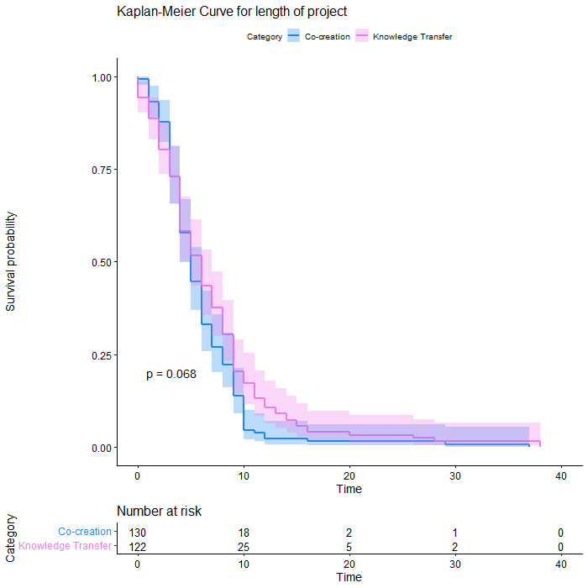
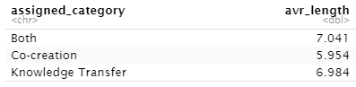
Appendix average length of project
Not significant
Notes:
Not significant

Slide 31
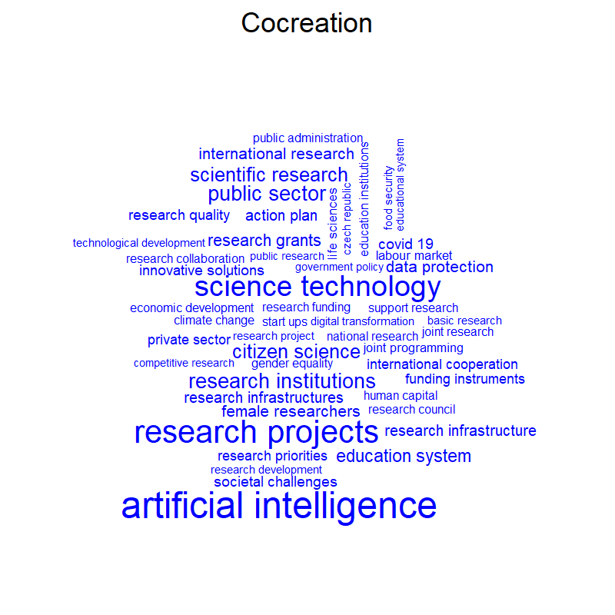
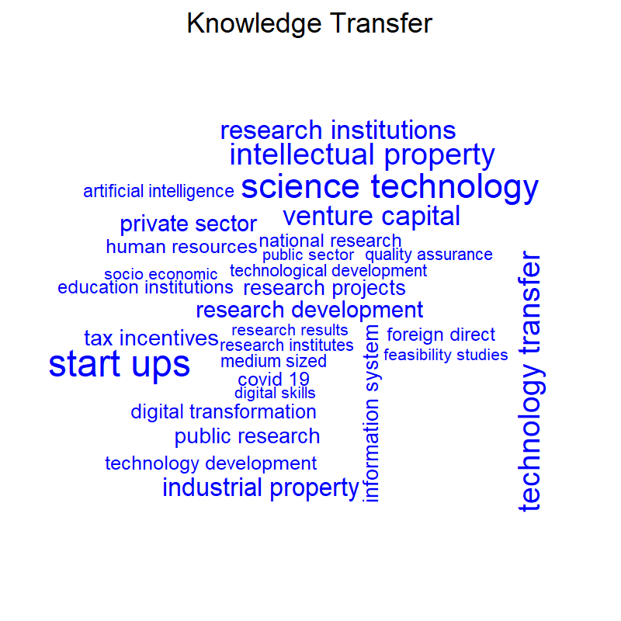
Appendix
Top 30 bigram policy texts
*Exclude policies with 50% Co-creation and Knowledge Transfer weight
Notes:
AI also appear in one of the clustered community. Triangulation supports the info in slide 16 and 17.

Slide 32
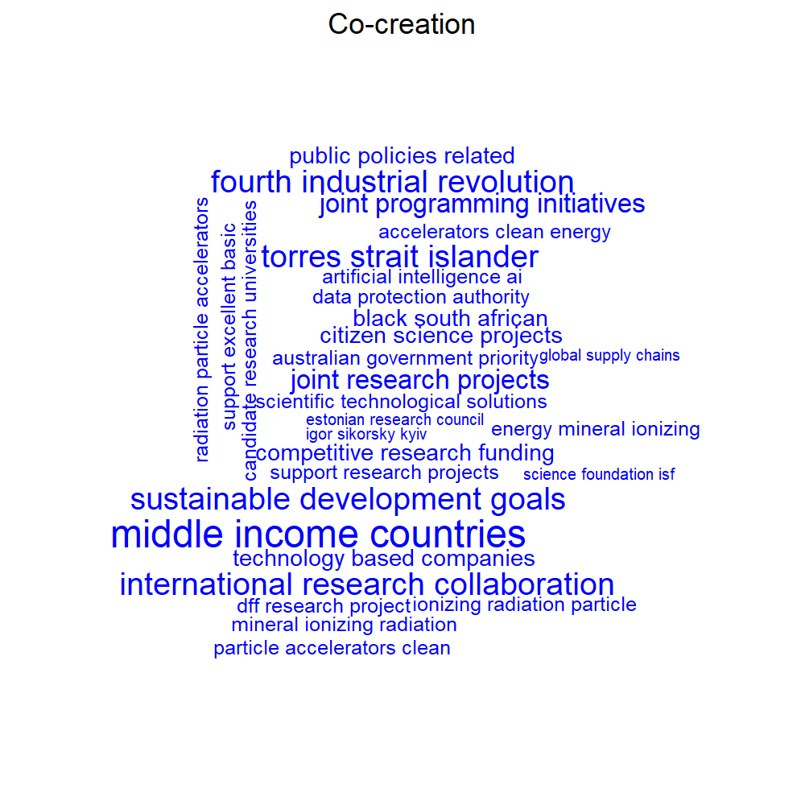
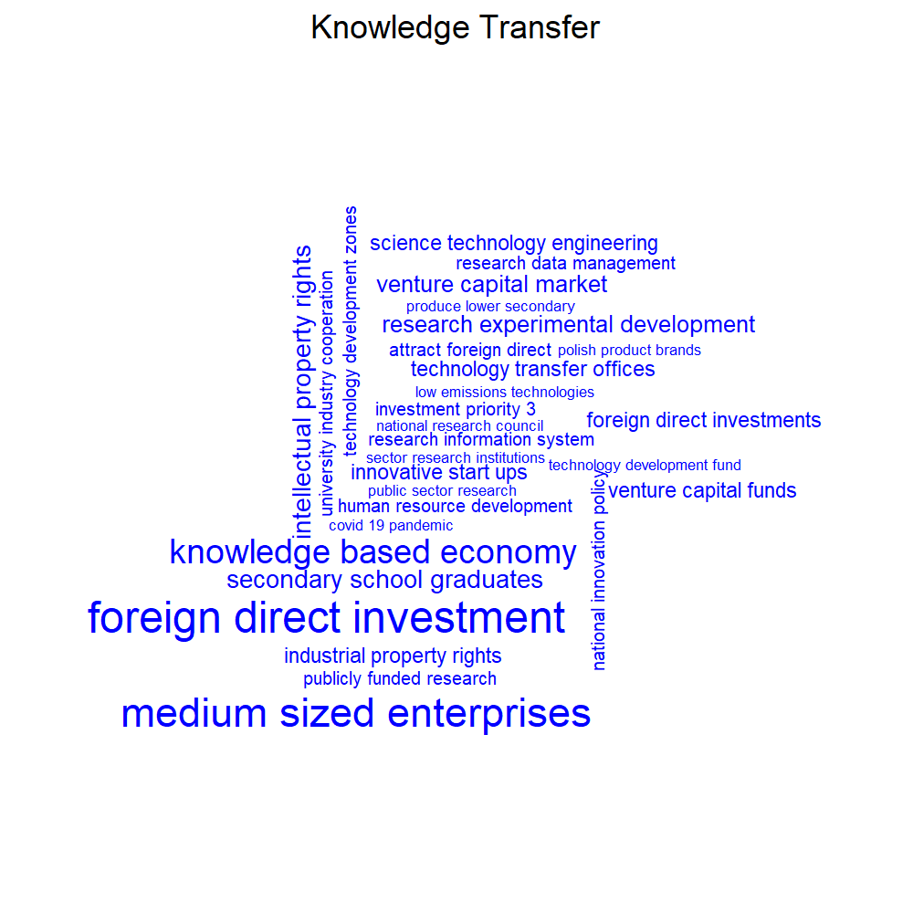
Top 30 trigram policy texts
Appendix
4 policies
4 policies
7 policies
9 policies
Notes:
This verifies the triangulation with slide 16 that co-creation involves the topics about energy and sustainable development goals.

Slide 33
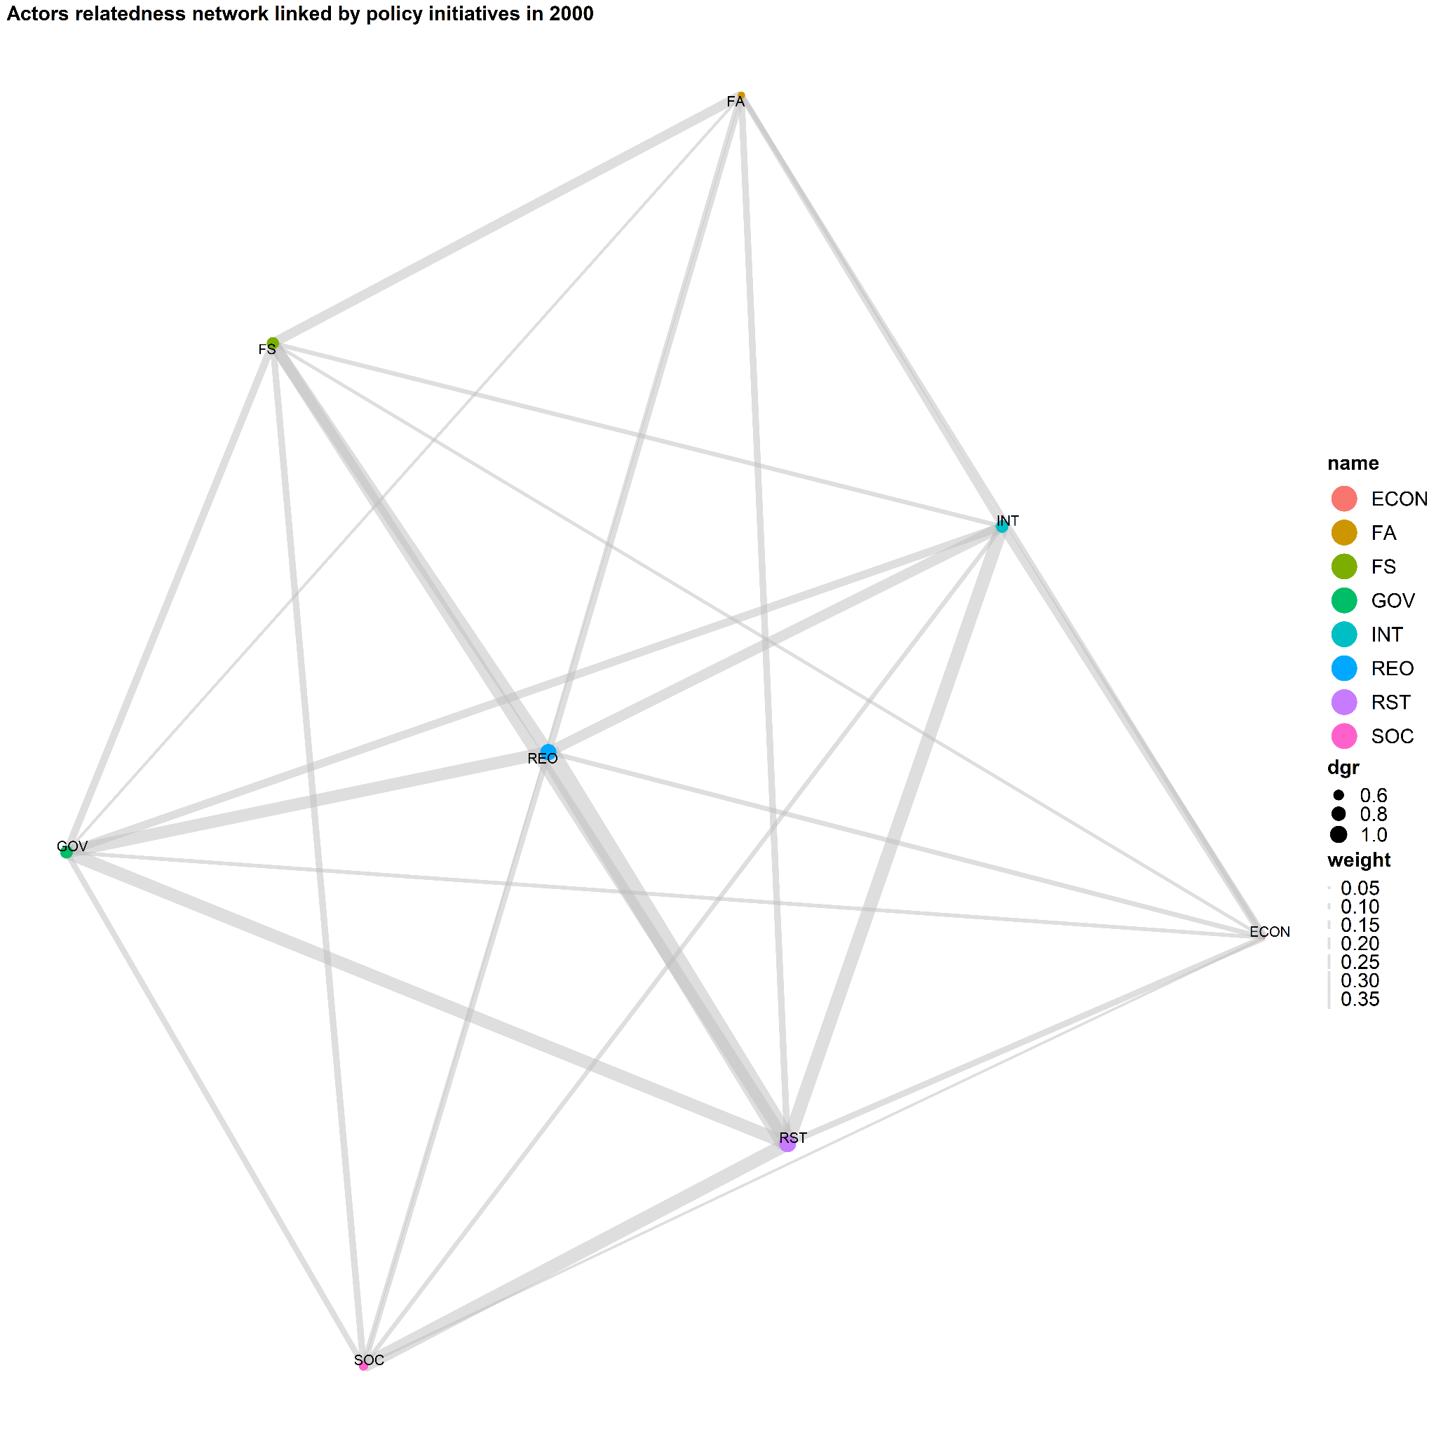
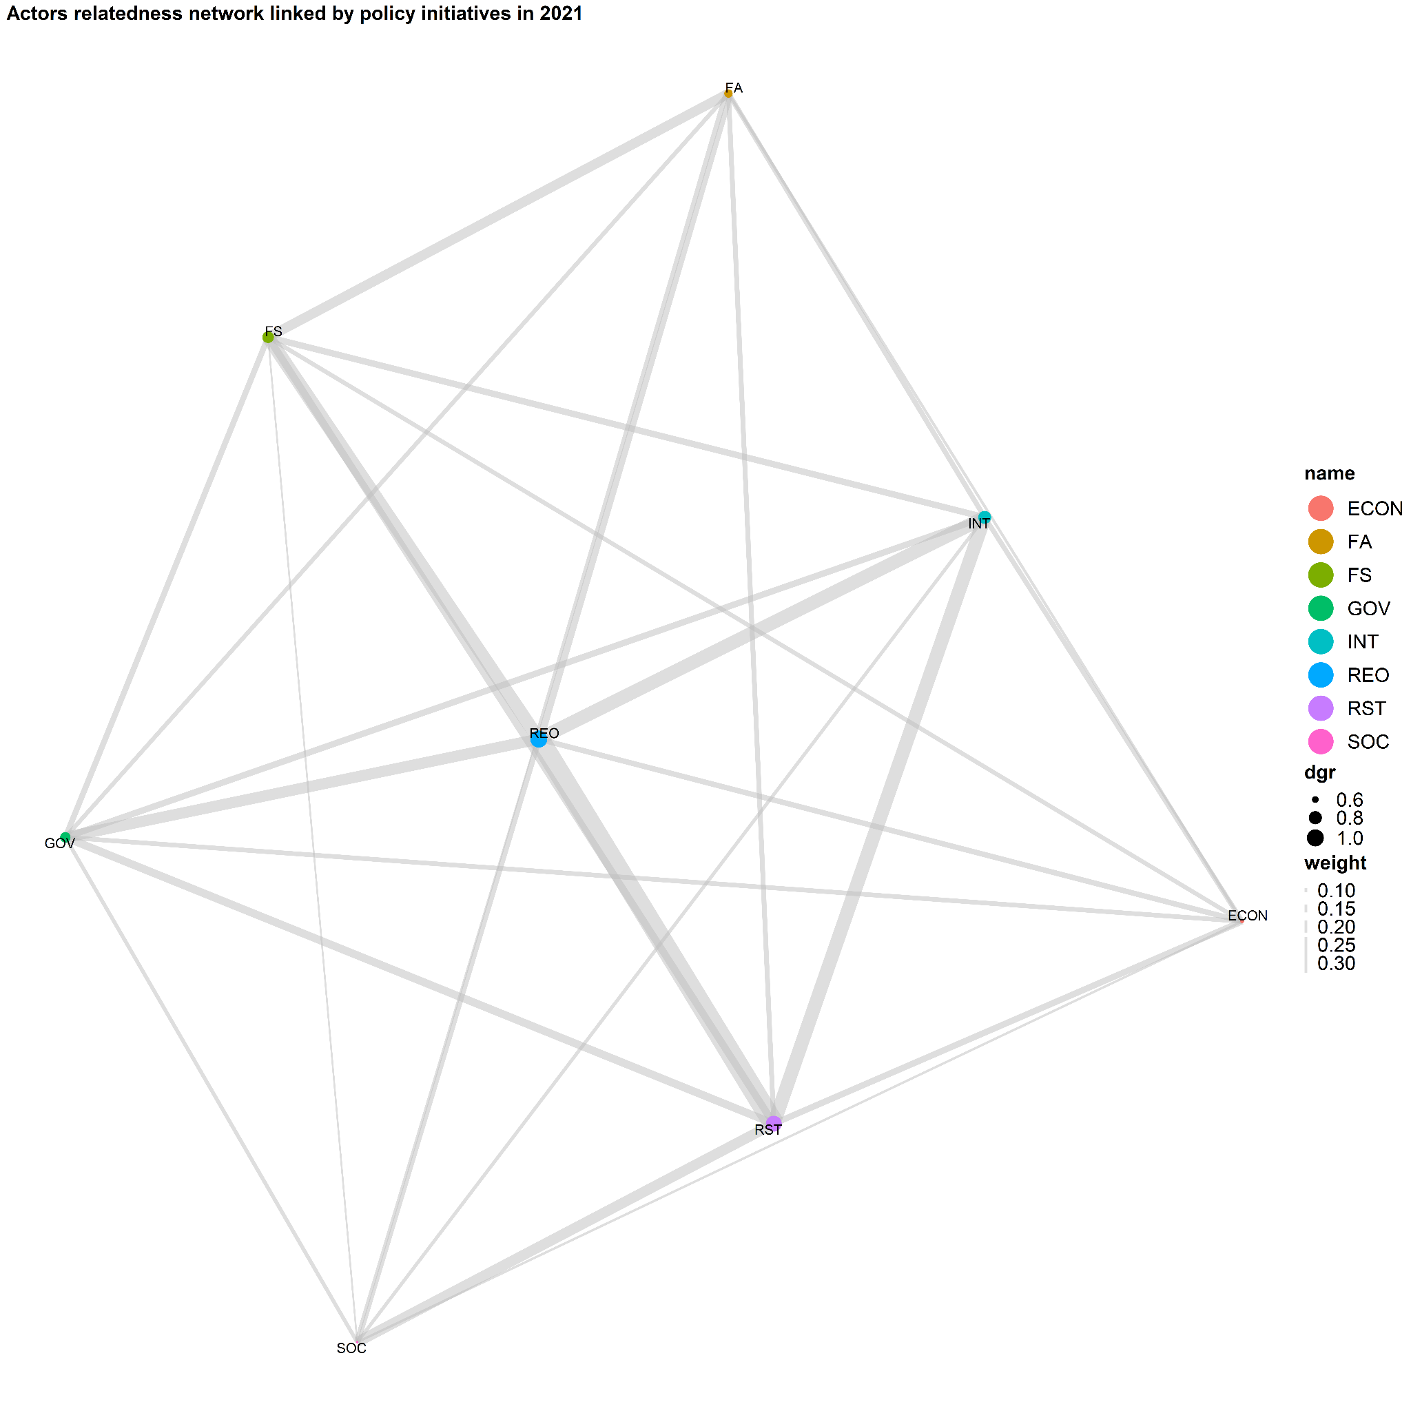
Appendix
Network of targeted actors
Edge: Number of policy initiatives
Nodes: Target groups
Notes:
High emphasis on Researchers target groups (REO & RST). Next are the firms (FS by size, FA by age) and the Intermediators (INT), then the government (GOV)

Slide 34
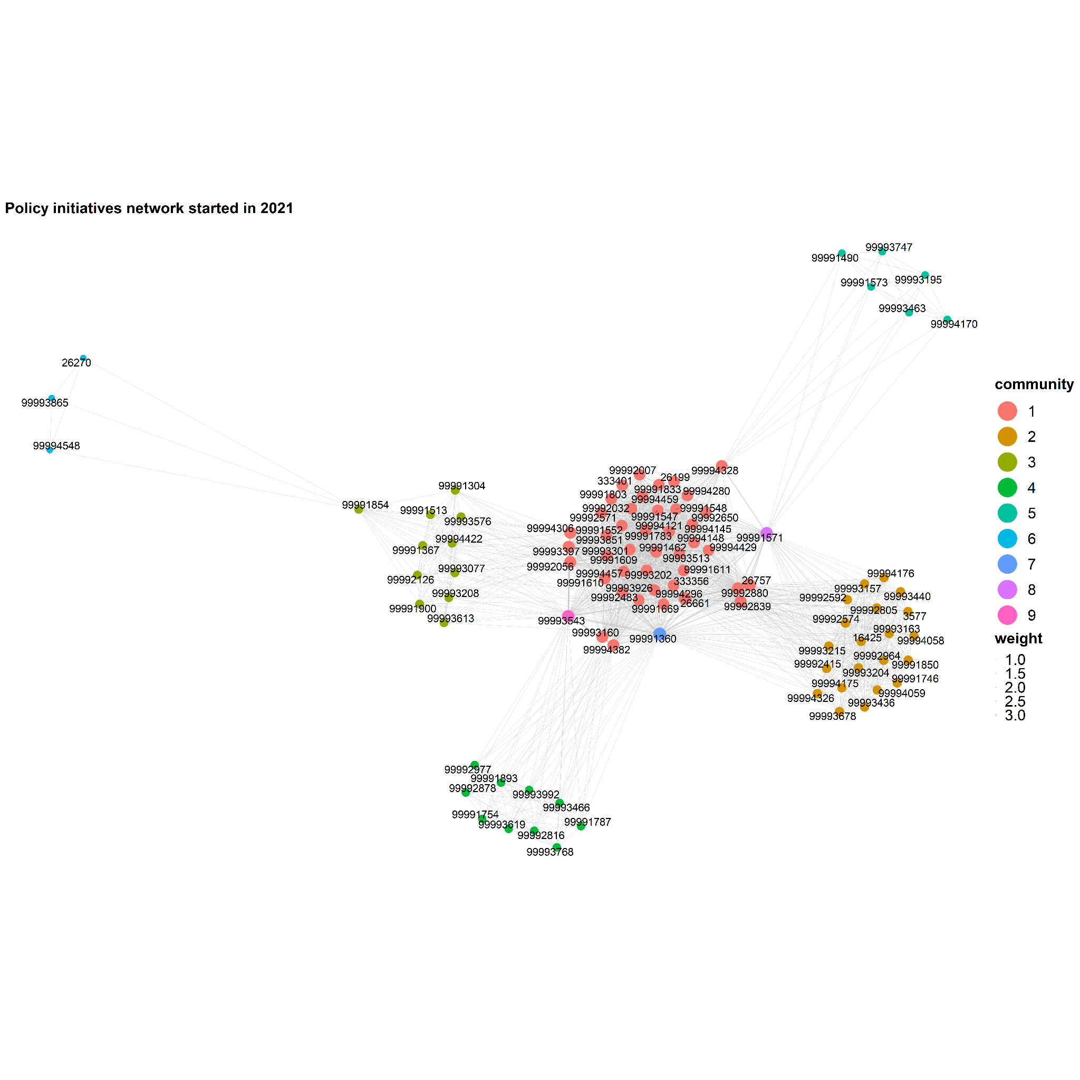
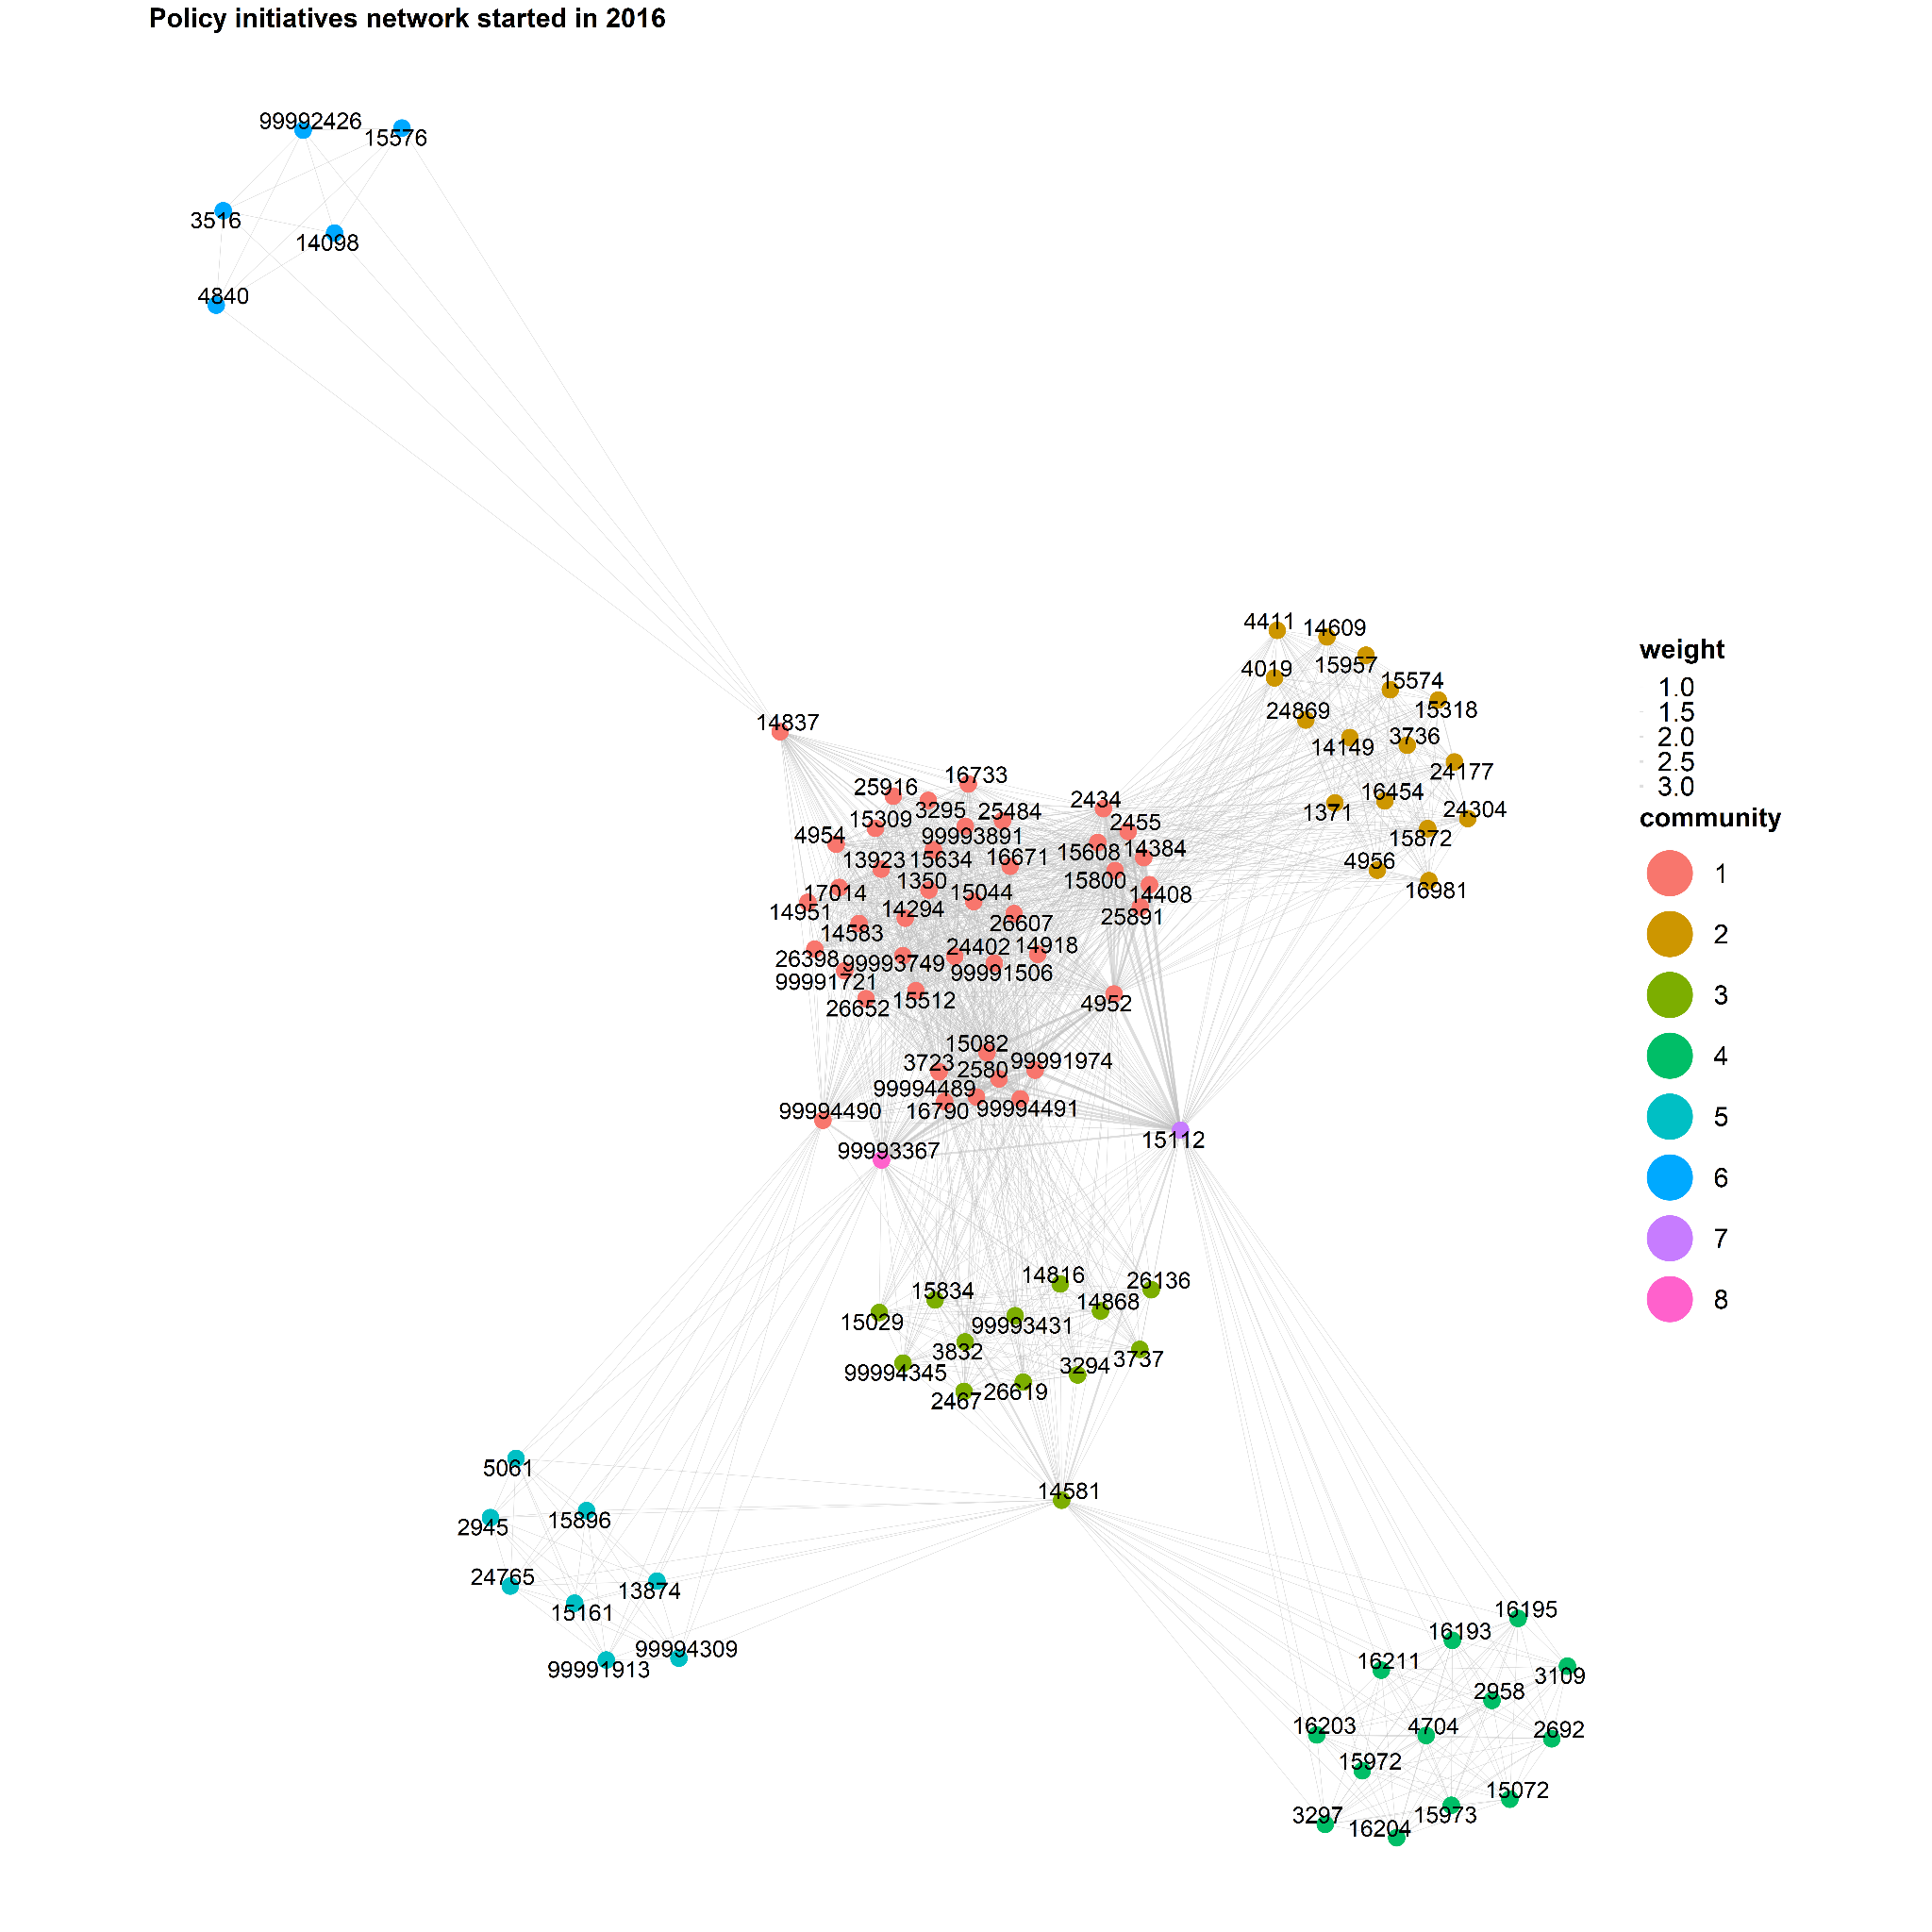
Appendix
Policy initiatives communities by themes
Notes:
Policies are clearly clustered by themes, so they tend to have only one theme in general.

Slide 35
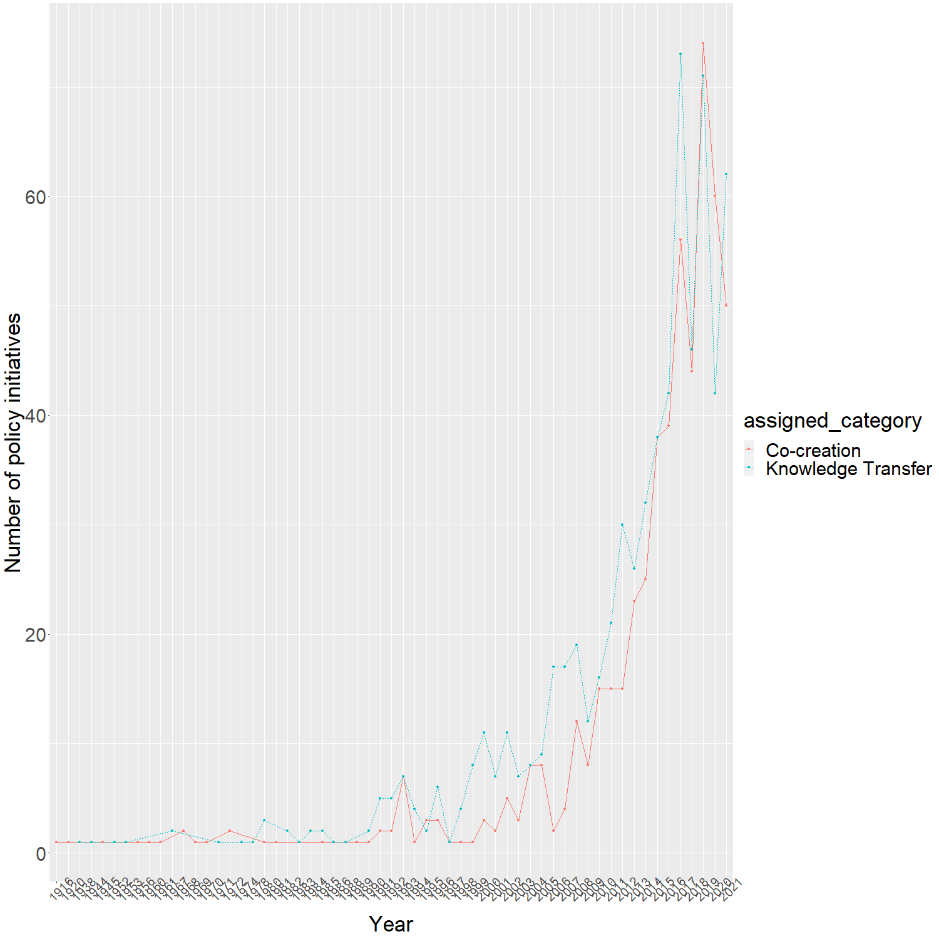
Appendix

Slide 36
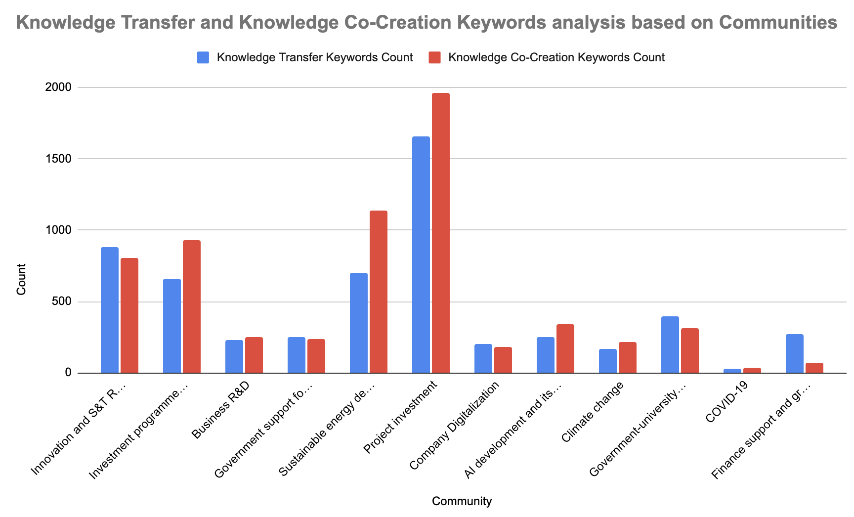
Timeline:
2013-2021
Notes:
This graph shows that the no. of co-creation keywords is higher than knowledge transfer policies in project investment and sustainable energy development 1995-2021
Modification to be made (Hamid):
y axis = count number of keywords in knowledge transfer in a strategy/ total keywords in knowledge transfer in all strategies (% or relative)
X axis <- - full words
Add top countries (Rank top 5 countries for each community See slide 26)

Slide 37
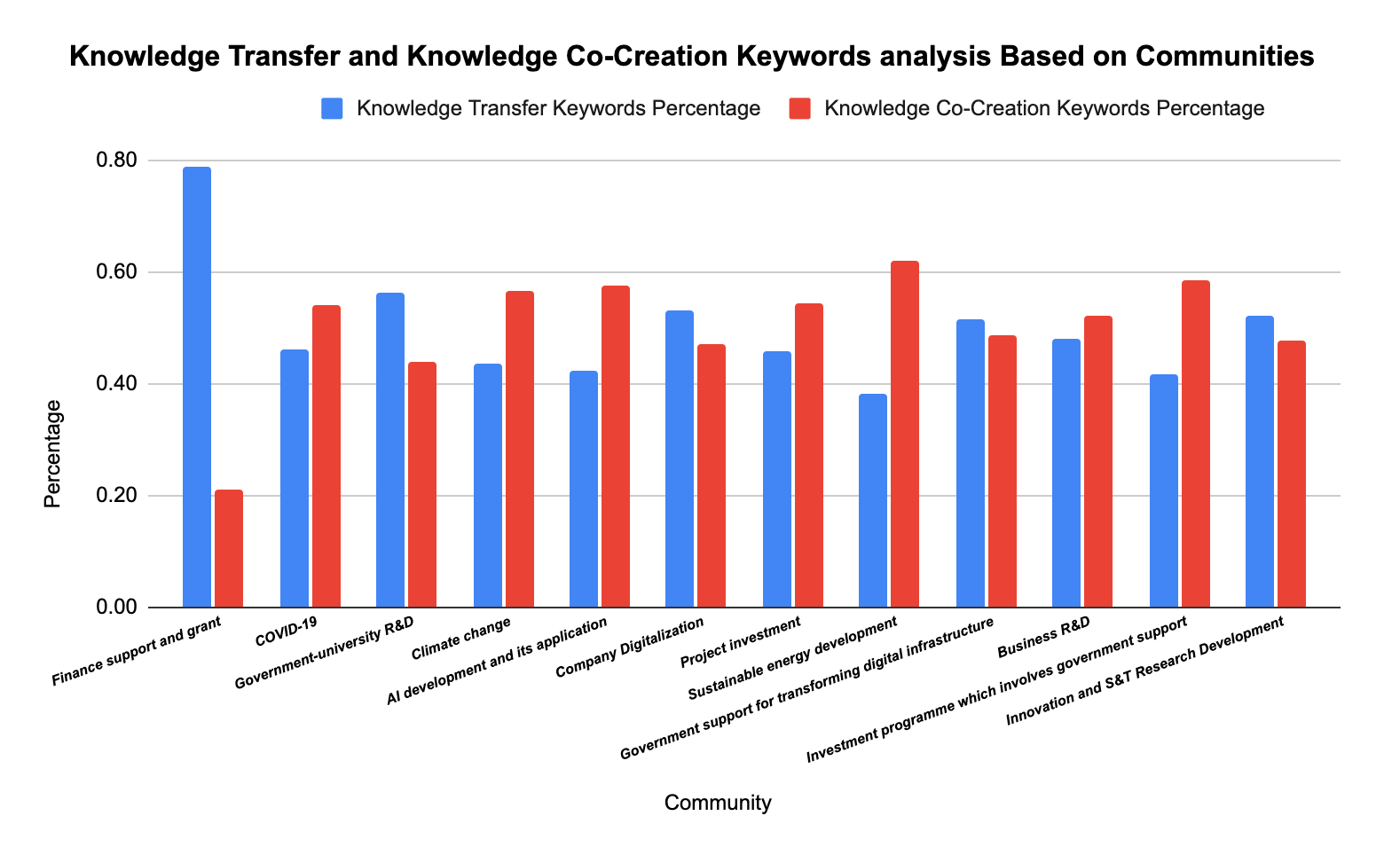
Timeline:
2013-2021
Notes:
This graph shows that the proportion of co-creation keywords is higher than knowledge transfer keywords in communities with topics about COVID-19, climate change, AI development. Most of these include Germany (4),Austria(3), Belgium (3), and Japan (2).
Year policy docs
1995.0 1
2013.0 4
2014.0 6
2015.0 7
2016.0 14
2017.0 10
2018.0 27
2019.0 51
2020.0 84
2021.0 84
Japan 25
United States 24
Germany 24
Canada 21
Costa Rica 16
Spain 16
Hungary 16
Ireland 15
Australia 14
Chile 13
Netherlands 11
France 11
Slovakia 11
Italy 11
Sweden 10
Austria 10
Luxembourg 9
Greece 9
United Kingdom 9
Switzerland 8
New Zealand 8
Finland 8
Korea 7
Belgium 7

Slide 38
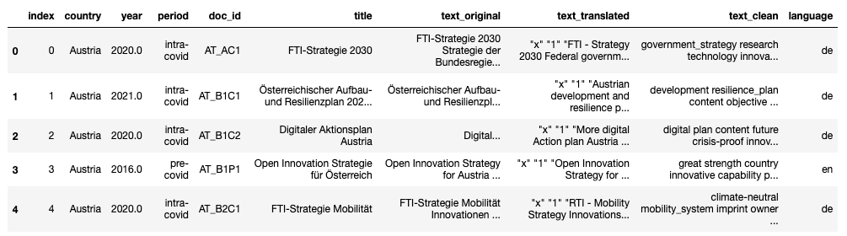
Unsupervised learning for policies clustering
We used two different approach for clustering text dataset:
TFIDF weighted w2v embeddings and Network Analysis (Semantic Similarity)
TFIDF weighted w2v embeddings and UMAP (Dimensionality Reduction)

Slide 39
KT
KCC
 | Innovation and S&T Research Development | Investment programme which involves government support | Business R&D | Government support for transforming digital infrastructure | Sustainable energy development | Project investment | Company Digitalization | AI development and its application | Climate change | Government-university R&D | COVID-19 | Finance support and grant
Austria | 1 | 1 | 0 | 0 | 0 | 0 | 1 | 1 | 1 | 0 | 0 | 0
Australia | 0 | 0 | 1 | 1 | 1 | 0 | 0 | 0 | 0 | 0 | 1 | 0
Belgium | 0 | 1 | 0 | 0 | 1 | 1 | 0 | 0 | 1 | 0 | 0 | 0
Canada | 0 | 1 | 1 | 1 | 1 | 0 | 0 | 0 | 0 | 0 | 0 | 0
Switzerland | 1 | 0 | 0 | 1 | 0 | 0 | 1 | 0 | 0 | 0 | 0 | 1
Chile | 1 | 0 | 0 | 0 | 1 | 0 | 0 | 1 | 1 | 0 | 0 | 0
Costa Rica | 1 | 0 | 0 | 0 | 1 | 0 | 1 | 1 | 1 | 0 | 0 | 0
Germany | 1 | 1 | 1 | 1 | 1 | 1 | 1 | 1 | 1 | 0 | 0 | 0
Spain | 1 | 0 | 0 | 0 | 1 | 1 | 0 | 1 | 0 | 0 | 0 | 0
Finland | 0 | 1 | 0 | 0 | 0 | 1 | 0 | 0 | 0 | 0 | 0 | 0
France | 1 | 1 | 0 | 1 | 0 | 1 | 0 | 0 | 0 | 0 | 0 | 0
Greece | 0 | 1 | 0 | 0 | 0 | 1 | 0 | 0 | 0 | 0 | 0 | 0
Hungary | 1 | 1 | 0 | 1 | 0 | 1 | 1 | 1 | 1 | 0 | 0 | 0
Ireland | 0 | 1 | 1 | 0 | 0 | 0 | 0 | 1 | 0 | 1 | 1 | 0
Italy | 1 | 0 | 0 | 0 | 0 | 1 | 1 | 0 | 0 | 0 | 0 | 1
Japan | 0 | 0 | 0 | 0 | 1 | 0 | 0 | 1 | 0 | 1 | 1 | 0
Korea | 0 | 0 | 0 | 0 | 1 | 0 | 0 | 1 | 0 | 0 | 0 | 0
Luxembourg | 0 | 1 | 0 | 1 | 0 | 1 | 0 | 0 | 0 | 0 | 0 | 0
Netherlands | 0 | 1 | 1 | 1 | 1 | 0 | 0 | 1 | 0 | 0 | 0 | 0
New Zealand | 0 | 0 | 1 | 0 | 0 | 0 | 0 | 0 | 0 | 0 | 0 | 1
Slovakia | 0 | 1 | 0 | 0 | 1 | 1 | 1 | 0 | 1 | 0 | 0 | 0
Sweden | 0 | 1 | 0 | 0 | 1 | 0 | 1 | 0 | 1 | 0 | 0 | 0
United Kingdom | 0 | 0 | 1 | 0 | 0 | 0 | 0 | 1 | 0 | 0 | 1 | 1
United States | 0 | 0 | 1 | 1 | 1 | 0 | 0 | 1 | 0 | 1 | 0 | 0
Notes:
Note to Hamid： Rank top 5 countries for each community

Slide 40
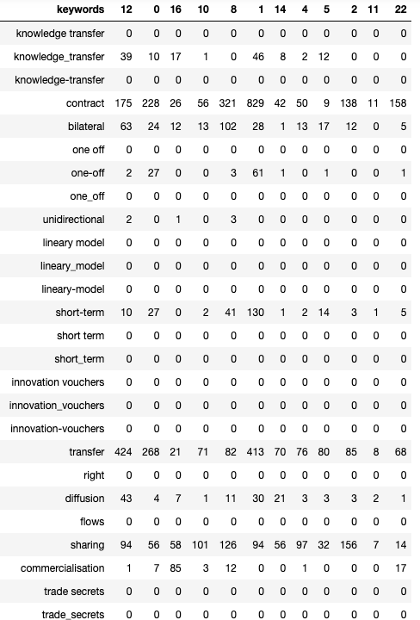
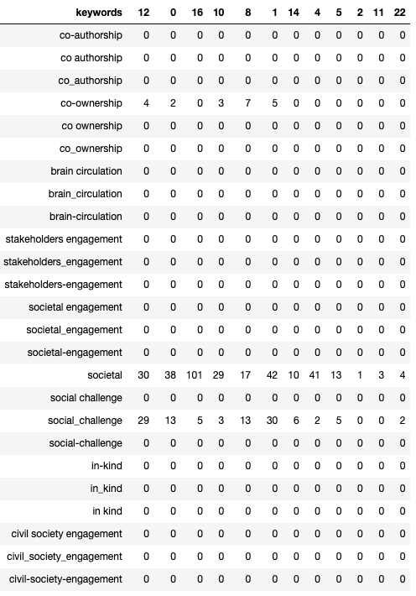
Appendix

Slide 41
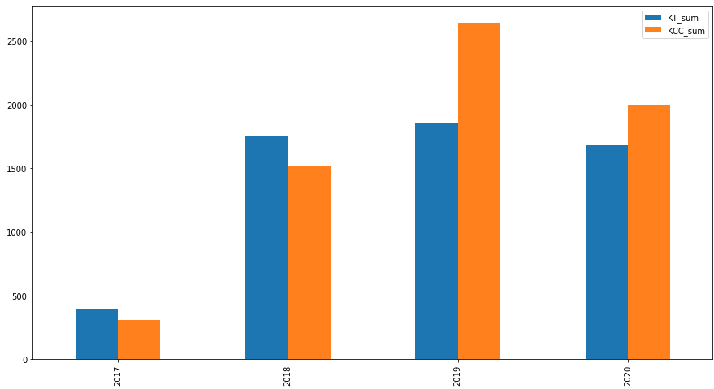
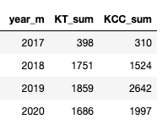
Appendix

Slide 42
Appendix
2017
2018
2019

Slide 43
Appendix
2020

Slide 44
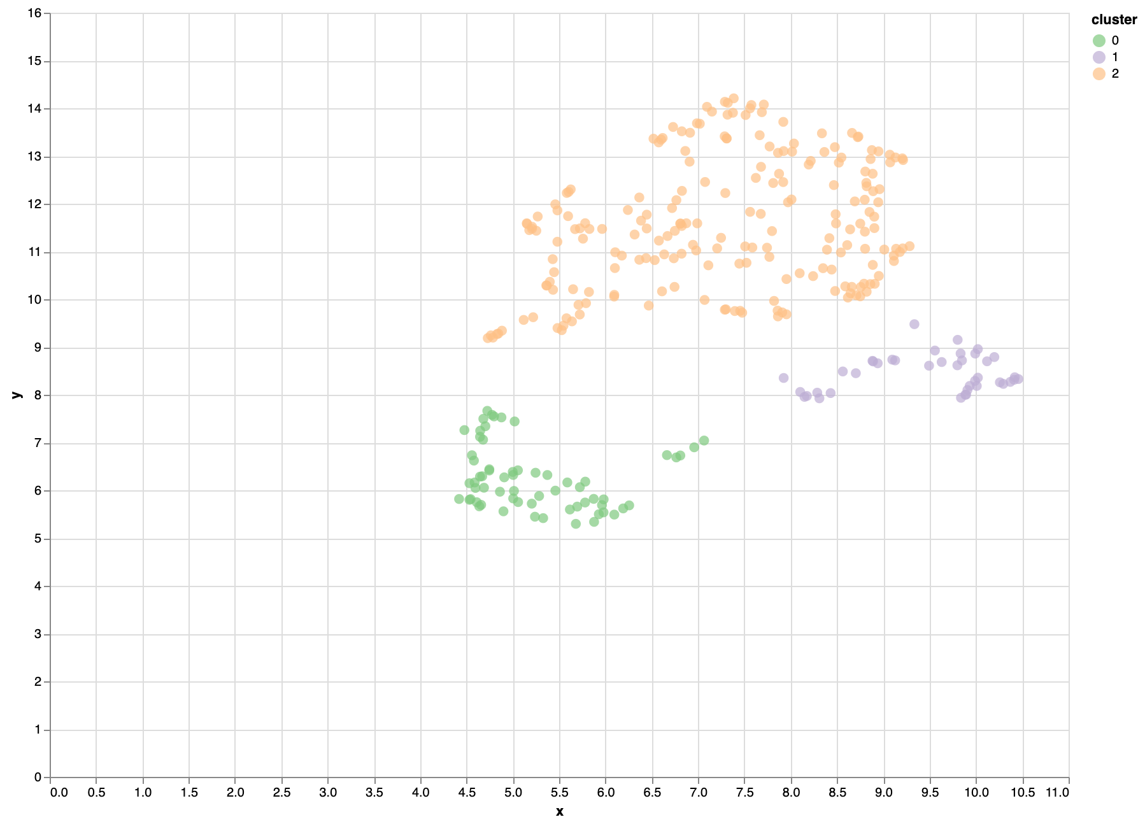
Appendix
TFIDF weighted w2v embeddings and UMAP (Dimensionality Reduction)
Policy

Slide 45
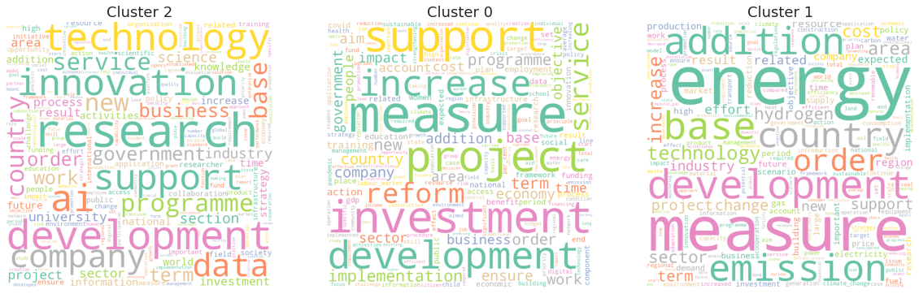
Appendix
TFIDF weighted w2v embeddings and UMAP (Dimensionality Reduction)

Slide 46
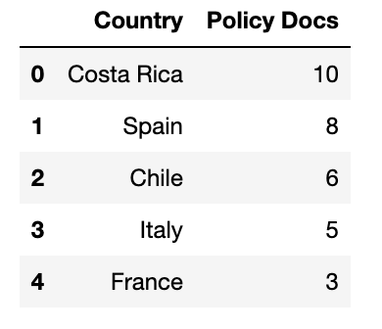
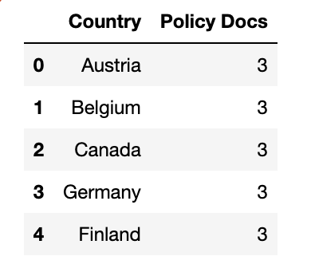




Top 5 countries with the highest number of policy initiatives in each community
Notes:
In terms of keywords, we plot communities that show high frequency of topics which are related to each other, e.g., Energy, COVID, AI related.
Total: 37,34,30,27,

Slide 47






Top 5 countries with the highest number of policy initiatives in each community
Notes:
In terms of keywords, we plot communities that show high frequency of topics which are related to each other, e.g., Energy, COVID, AI related.

Slide 48
STI Scoreboard - PCA triangulation with STIP COMPASS
Appendix
How do the Indicators correlate with number of KT- and CC initiatives?
Left-side variables | Correlation with no. of CC initiatives | Correlation with no. of KT initiatives
GERD financed by the business enterprise sector (% GDP) | Negative | Negative
HERD financed by the business enterprise sector (% total HERD) | Negative | Negative
International co-invention (% total PCT patent applications) | Negative | Negative
BERD financed by government (% total BERD) | No correlation | No correlation
NOTE: See Apeendix for correlation matrix

Slide 49
STI Scoreboard - PCA triangulation with STIP COMPASS
Appendix
How do the Indicators correlate with number of KT- and CC initiatives?
Right-side variables | Correlation with no. of CC initiatives | Correlation with no. of KT initiatives
BERD as a percentage of GDP | Positive | Positive
GERD as a percentage of GDP | Positive | Positive
GOVERD as a percentage of GDP | Positive | Positive
GOVERD financed by the business enterprise sector (% total GOVERD) | Positive | Positive
NOTE: See Apeendix for correlation matrix

Slide 50


STI Scoreboard - Cluster characteristics
Appendix
“Right-side” variables (positive correlation with KT and CC)
Cluster 1 are overall scoring low on KT and CC, while cluster 2 and 3 have a higher score on KT and CC
“Left-side” variables (negative correlation with KT and CC)

Slide 51

Co-creation correlation matrix

Slide 52

Appendix
Knowledge Transfer correlation matrix

Slide 53

Appendix

